Slide 1
Local responses to a global pandemic: experiences from a collaborative partnership spanning nine countries
7th Global Symposium on Health Systems Research
November 4, 2022
Isabel Fulcher, Harvard Medical School, USA
Alphonse Nshimyiryo, Inshuti Mu Buzima, Rwanda
Zeus Aranda, Compañeros En Salud, Mexico
Marco Tovar, Socios En Salud, Peru
Emilia Connolly, Abwenzi Pa Za Umoyo, Malawi
Bethany Hedt-Gauthier, Harvard Medical School, USA

Slide 2




Introduction & Overview
Research lightning talks
Capacity building initiatives
Contributor Question & Answer
Isabel Fulcher, PhD
Former Postdoctoral Fellow
Harvard Medical School, USA

Slide 3

Introduction & Overview
Research lightning talks
Capacity building initiatives
Contributor Question & Answer
Isabel Fulcher, PhD
Former Postdoctoral Fellow
Harvard Medical School, USA
Alphonse Nshimyiryo, MS
Data Analyst
Inshuti Mu Buzima, Rwanda
Zeus Aranda, MS
Research & Impact Coordinator
Compañeros En Salud, Mexico
Marco Tovar, MD
Medical Director
Socios En Salud, Peru
Emilia Connolly, MPH, MD
Chief Health Systems Policy Advisor Abwenzi Pa Za Umoyo, Malawi

Slide 4

Introduction & Overview
Research lightning talks
Capacity building initiatives
Contributor Question & Answer
Isabel Fulcher, PhD
Former Postdoctoral Fellow
Harvard Medical School, USA
Alphonse Nshimyiryo, MS
Data Analyst
Inshuti Mu Buzima, Rwanda
Zeus Aranda, MS
Research & Impact Coordinator
Compañeros En Salud, Mexico
Marco Tovar, MD
Medical Director
Socios En Salud, Peru
Emilia Connolly, MPH, MD
Chief Health Systems Policy Advisor Abwenzi Pa Za Umoyo, Malawi
Bethany Hedt-Gauthier, PhD
Associate Professor
Harvard Medical School, USA

Slide 5

Introduction & Overview
Research lightning talks
Capacity building initiatives
Contributor Question & Answer
Isabel Fulcher, PhD
Former Postdoctoral Fellow
Harvard Medical School, USA
Alphonse Nshimyiryo, MS
Data Analyst
Inshuti Mu Buzima, Rwanda
Zeus Aranda, MS
Research & Impact Coordinator
Compañeros En Salud, Mexico
Marco Tovar, MD
Medical Director
Socios En Salud, Peru
Emilia Connolly, MPH, MD
Chief Health Systems Policy Advisor Abwenzi Pa Za Umoyo, Malawi
Bethany Hedt-Gauthier, PhD
Associate Professor
Harvard Medical School, USA
Please go to
www.menti.com
Enter code
5535 6338
Submit questions during the session!

Slide 6

The Global Health Delivery Partnership
Division of Global Health Equity
Brigham and Women’s Hospital
Global Health Research Core
Dept of Global Health and Social Medicine
Harvard Medical School
Partners In Health

Slide 7
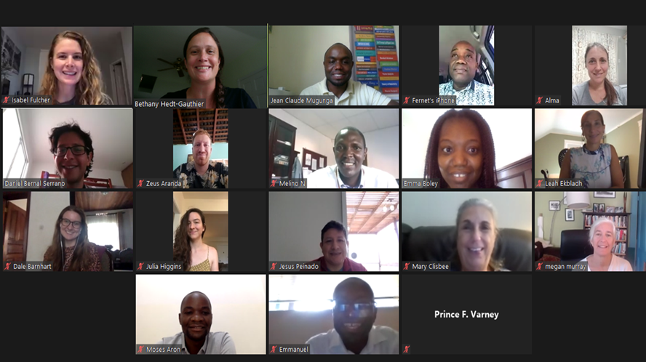

Cross-PIH site collaboration
Facilitate the development of high-quality COVID-related research at sites
Reduce duplicative work across both sites and clinical areas
Harmonize processes in a way that enables cross-site analyses
Promote equitable opportunities for participation in research and research dissemination

Slide 8
We implemented a variety of studies
Serosurveillance – what is the burden of COVID-19?
Cohort studies – how has COVID-19 affected specific populations?
Using routine health systems data for:
Syndromic surveillance – what regional areas may be having higher than expected rates of COVID-19-associated symptoms?
Health service utilization – did the number of individuals receiving care change during the COVID-19 pandemic?

Slide 9
Serosurveillance
Methods development: Extending lot quality assurance sampling to account for imperfect tests (Fulcher et al, 2022, BMC Public Health)
Protocol guidance: Should individuals receive the results of their antibody tests? (Mugunga et al., 2021, The Lancet)
Serosurveys: Supporting countries design studies and/or analyze data
Antibody tests among health workers in Haiti in April-September 2020
Population-based seroprevalence studies in Peru and Mexico

Slide 10
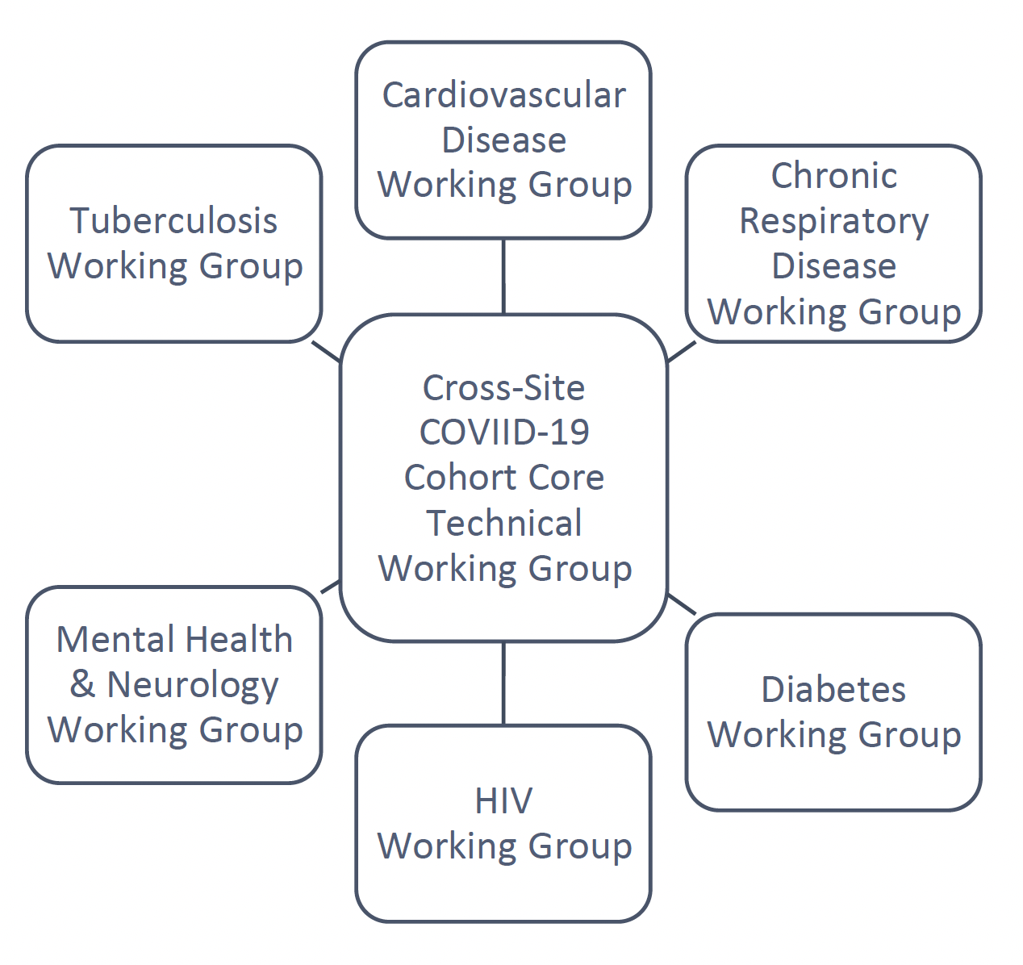
Cohort studies
To understand:
Epidemiology and progression of disease, overall and in specific risk-groups.
Changes in care and/or outcomes for chronic care patients.
Activities:
Create overall cohort designs that align with sites’ priorities
Develop data collection tools .
Facilitate protocol development and ethical approvals, including providing a core protocol template.
Harmonize data collection and processing procedures.
Seek funding to support activities centrally and at sites.
PIH Cross-Site COVID-19 Cohort Research Network:
A central core technical working group coordinated across multiple disease-specific teams

Slide 11
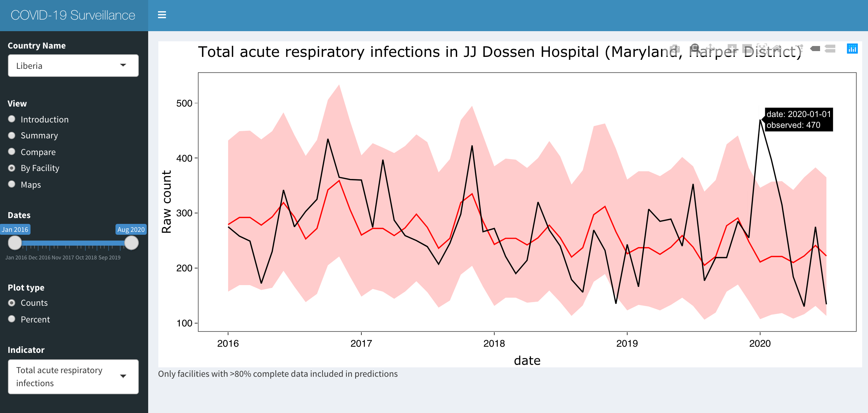
Using routine health systems data
Methods development:
Identifying deviations using monthly time series data
Monthly monitoring
Cross-site research
Acute respiratory infections in Liberia (Fulcher et al., IJE, 2021)
Childhood immunizations (Connolly et al., WHO Bulletin, 2021)
Maternal health service utilization (Aranda et al., BMJ Global Health, 2021)

Slide 12
How did the cross-site collaboration work?
Identifying research questions
Assembling a cross-site team
Ethical approvals & data sharing
Gathering resources
Biweekly working group meetings from April 2020 to June 2022
Brainstorm potential research activities
Assess interest across site to assemble a team
Decide on project roles at outset
Typically, 1-2 lead writers, 1-2 analysts, 1 scientific lead
Site-specific contributors
Identify what additional training or support is needed
Site-specific IRBs and DUAs
Non-PIH analysts (at Harvard) approved by each site
Governance structure documents were key for larger coordination
Technical support from graduate students, aligned with thesis goals
Received 3 grants to fund cross-site efforts, but some work was still unfunded

Slide 13
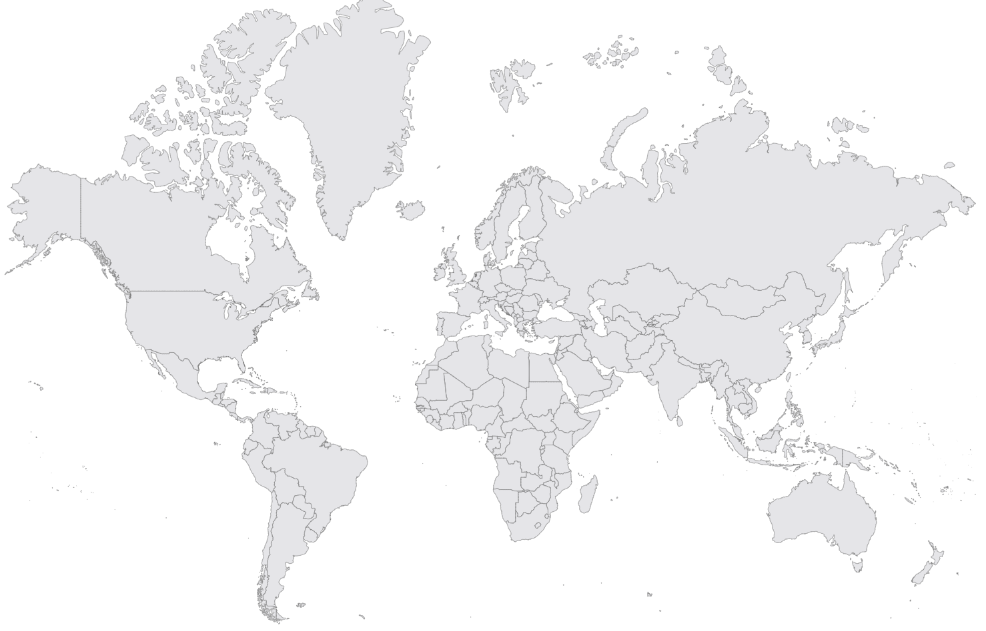
COVID-19 Multicountry Research Group
PIH/Boston
Nidia Correa
Jean Claude Mugunga
Natalie Price
PIH/Mexico
Zeus Aranda
Daniel Bernal
PIH/Peru
Leonid Lecca
Jesus Peinado
PIH/Malawi
Moses Aron
Emilia Connolly
PIH/Rwanda
Vincent Cubaka
Nadine Karema
Frederick Katera
PIH/Liberia
Emma Boley
Rebecca Cook
Prince Varney
PIH/Haiti
Peterson Abnis I Faure
Mary Clisbee
Wesler Lambert
Fernet Leandre
Jeune Marc Antionne
PIH/Lesotho
Thiane Mohlouoa
Meba Msuya
Melino Ndayizigiye
Patrick Nkundanyirazo
PIH/Sierra Leone
Thierry Binde
Chiyembekezo Kachimanga
Harvard Medical School
Alma Adler
Dale Barnhart
Leah Ekbladh
Molly Franke
Isabel Fulcher
Bethany Hedt-Gauthier
Megan Murray
Interns
Katherine Collamore
Don Fejfar
Anuraag Gopulani
Nichole Kulikowski
Ananya Tadikonda
Kate Tashman
Kartik Tyagi
Karina Vasudeva
Jessica Wang
University of British Columbia
Michael Law
University of Hong Kong
Karen Grepin

Slide 14
Submit your questions for Q&A!
After each research talk, there will be 2 minutes to ask clarifying questions
Submit other questions via www.menti.com
Moderator will collate questions for Q&A
If question is for specific presenter, please reference their first or last name
Questions will be public but can remain anonymous
Please go to
www.menti.com
Enter code
5535 6338

Slide 15
The Impact of COVID-19 on Access to Cancer Care in Rwanda: A Retrospective Time-series Study Using Electronic Medical Records Data
Authors:
Placide Habinshuti¹, Alphonse Nshimyiryo¹, Donald Fejfar², Anne Niyigena¹, Vincent K. Cubaka¹, Nadine Karema¹, Jean Bosco Bigirimana¹, Cyprien Shyirambere¹, Dale A. Barnhart^{1,3}, Fredrick Kateera¹, Isabel Fulcher⁴ on behalf of The Cross-Site COVID-19 Technical Working Group
Affiliations:
¹Partners In Health/Inshuti Mu Buzima (PIH/IMB), Kigali, Rwanda
²Partners In Health, Boston, United States of America (USA)
³Harvard Medical School, Boston, USA
⁴Department of Global Health and Social Medicine, Harvard Medical School, Boston, USA
Presenter:
Alphonse Nshimyiryo,
Data Analyst, Department of Research and Training, PIH/IMB
November 4, 2022

Slide 16
Background
Worldwide, the COVID-19 pandemic disrupted the provision of and access to routine healthcare services.
Chronic care patients, including cancer patients and people living in resource-limited settings have particularly been vulnerable.
However, little is known about the impact of COVID-19 on access to cancer care in low- and middle-income countries.
In this study, we assessed the impact of COVID-19 on access to cancer care in Rwanda.
We used electronic medical record (EMR) system data collected at the Butaro Cancer Center of Excellence between January 2016 and July 2021.

Slide 17
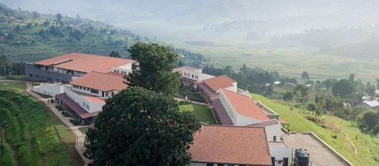
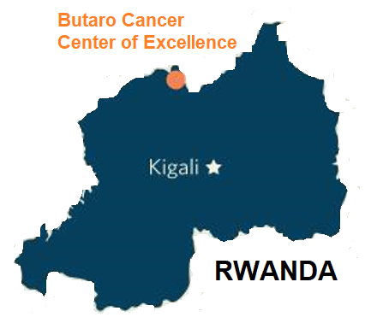
Butaro Cancer Center of Excellence (BCCOE)
Established in 2012 as the first cancer center in Rwanda.
Cancer care services at the BCCOE, include:
pathology-based diagnosis,
basic imaging,
chemotherapy, and
surgery.

Slide 18
Methods
We collected data on 8,970 patients who were observed during the study period:
7,140 patients in pre-COVID-19 (January 2016 – February 2020)
1,830 patients during COVID-19 (March 2020 – July 2021)
Measured outcomes, were the monthly number of new patients, number of clinical visits attended, number of scheduled appointments, and proportion of timely visits.
We did fit a generalized linear model with negative binomial distribution to predict outcomes for the COVID-19 period.
We computed monthly deviations (i.e. observed minus predicted count), and percent deviations.
All estimates were computed along with 95% prediction intervals.

Slide 19
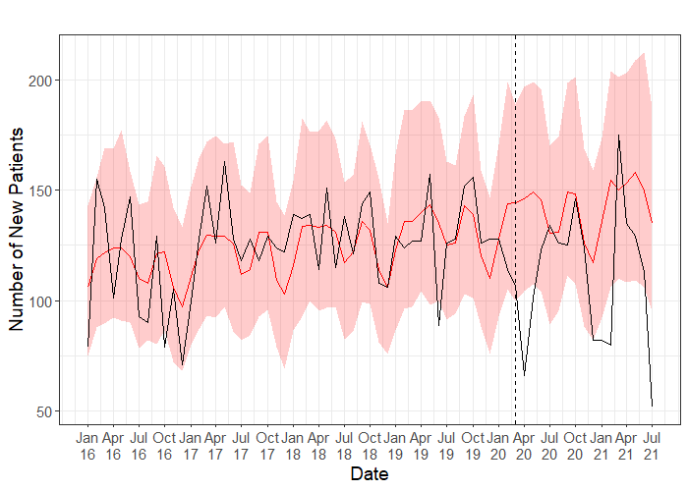
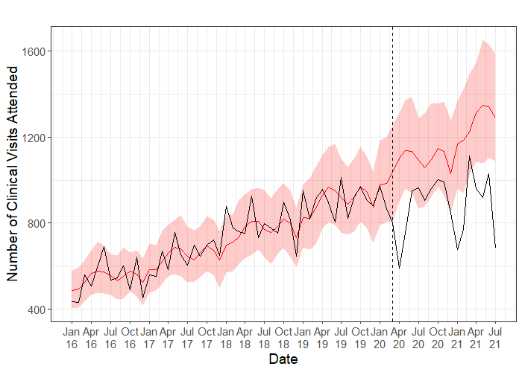
Time series models of new patients and clinical visits attended in pre-COVID-19 (January 2016 – February 2020) and during the pandemic (March 2020 – July 2021)

Slide 20
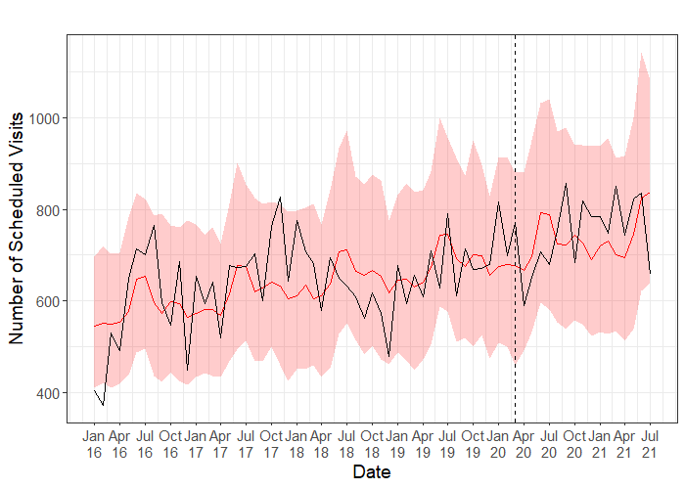
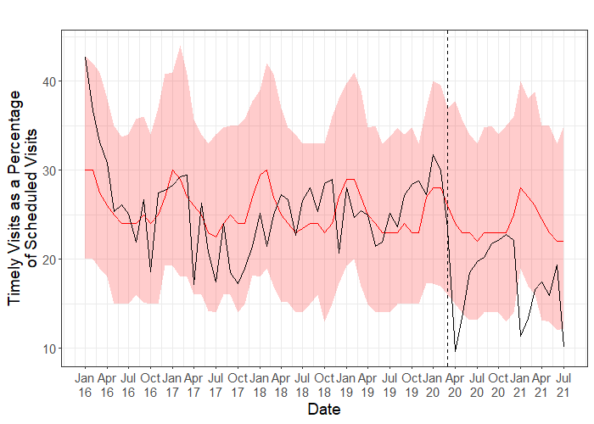
Time series models of scheduled appointments and timely visits as a percentage of scheduled appointments in pre-COVID-19 (January 2016 – February 2020) and during the pandemic (March 2020 – July 2021)

Slide 21
Cumulative counts and estimated deviations of outcomes during the COVID-19 period (March 2020 – July 2021)
Outcome | Observed Count | Expected Count | Estimated Deviation | Est. Percent Deviation (95% PI)
New Patients | 1900 | 2425.5 | -525.5 | -21.7% (-31.3%, -11.7%)
Scheduled Visits | 12741 | 12610.5 | 130.5 | 1.0% (-10.1%, 13.1%)
Clinical Visits Attended | 14911 | 19889.0 | -4978.0 | -25.0% (-31.1%, -19.1%)
Timely Visits (%) | 298.2 | 413.5 | -115.3 | -27.9% (-39.8%, -14.1%)

Slide 22
Discussion
We observed a significant drop in access to cancer care at the BCCOE during the COVID-19.
This could be attributed to the imposed measures to halt the spread of COVID-19 in Rwanda, including:
national and regional lockdowns,
restrictions on movements of people between places, and
suspension of public transport.
We particularly reported the largest declines in April 2020, January-February 2021 and July 2021 when these measures were imposed in Rwanda.
Our findings suggest delayed cancer diagnosis and treatment, which both may lead to negative health outcomes among our patient population in the coming months and years.
Notes:
A significant reduction in the cancer patient volume at health facilities during COVID-19 has also been reported from many other African countries¹ and Mexico².
¹Martei YM, Rick TJ, Fadelu T, et al. Impact of COVID-19 on Cancer Care Delivery in Africa: A Cross-Sectional Survey of Oncology Providers in Africa. JCO Global Oncology. 2021;(7):368-377. https://ascopubs.org/doi/pdf/10.1200/GO.20.00569
²Doubova S V, Leslie HH, Kruk ME, Pérez-Cuevas R, Arsenault C. Disruption in essential health services in Mexico during COVID-19: an interrupted time series analysis of health information system data. BMJ Global Health. 2021;6:6204. https://gh.bmj.com/content/6/9/e006204

Slide 23
Thank you!!
To submit Q&A questions, go to www.menti.com & enter code 5535 6338

Slide 24


Implementation and evolution of a community health worker-led COVID-19 contact tracing intervention in Chiapas, Mexico
November 4, 2022
Zeus Aranda Remon
Research & Impact Coordinator, Partners In Health Mexico (Compañeros En Salud)

Slide 25
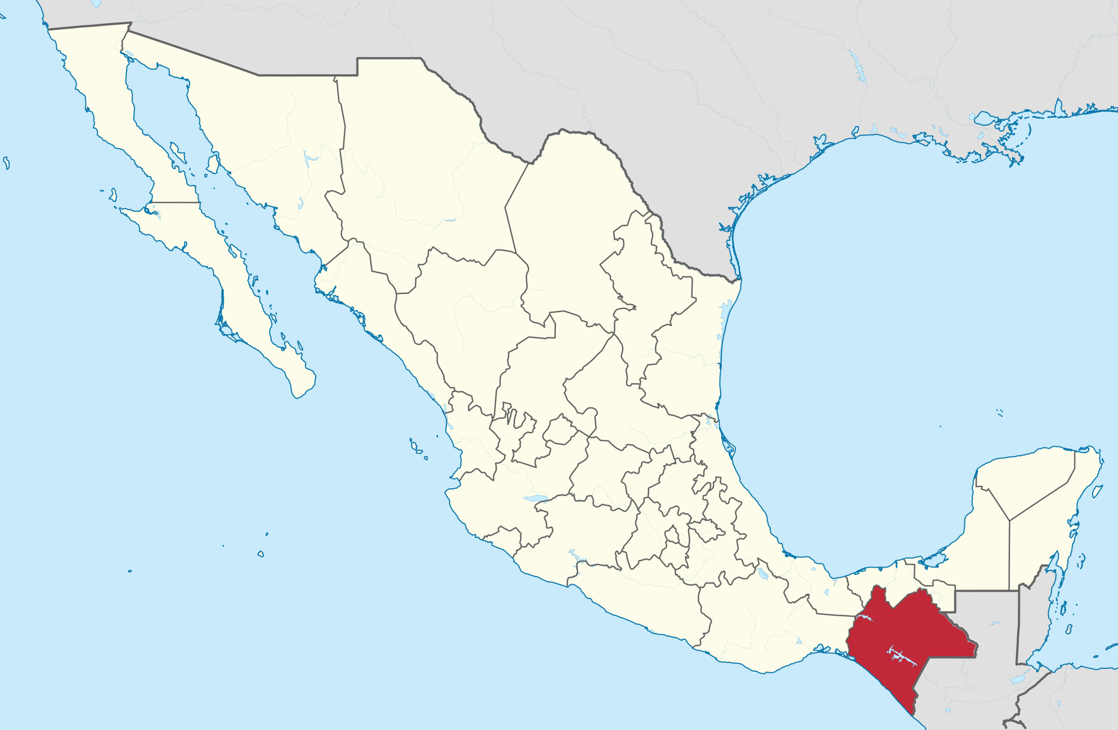
Wikimedia Commons
Authors
Zeus Aranda^{1,2}, Sandra Vázquez¹, Anuraag Gopaluni³, Laura Martínez⁴, Mayra Ramírez¹, Ariwame Jiménez¹, Daniel Bernal⁵, Ana L. Rodríguez^{1,6}, Selene Chacón⁶, Bruno Vargas¹, Isabel R. Fulcher^{7,8}, Dale A. Barnhart^{7,9}, Cross-site COVID-19 Syndromic Surveillance Working Group
¹Partners In Health Mexico (Compañeros En Salud), Ángel Albino Corzo, Chiapas, México. ²Departamento de Salud, El Colegio de la Frontera Sur, San Cristóbal de las Casas, Chiapas, México. ³Department of Biostatistics, Harvard T.H. Chan School of Public Health, Boston, MA, USA. ⁴Partners In Health Peru (Socios En Salud), Lima, Perú. ⁵Escuela de Gobierno y Transformación Pública, Instituto Tecnológico de Monterrey, Ciudad de México, México. ⁶Instituto Nacional de Salud Pública/Escuela de Salud Pública de México, Cuernavaca, Morelos, México. ⁷Department of Global Health and Social Medicine, Harvard Medical School, Boston, MA, USA. ⁸Harvard Data Science Initiative, Boston, MA, USA. ⁹Partners In Health Rwanda (Inshuti Mu Buzima), Kigali, Rwanda.

Slide 26
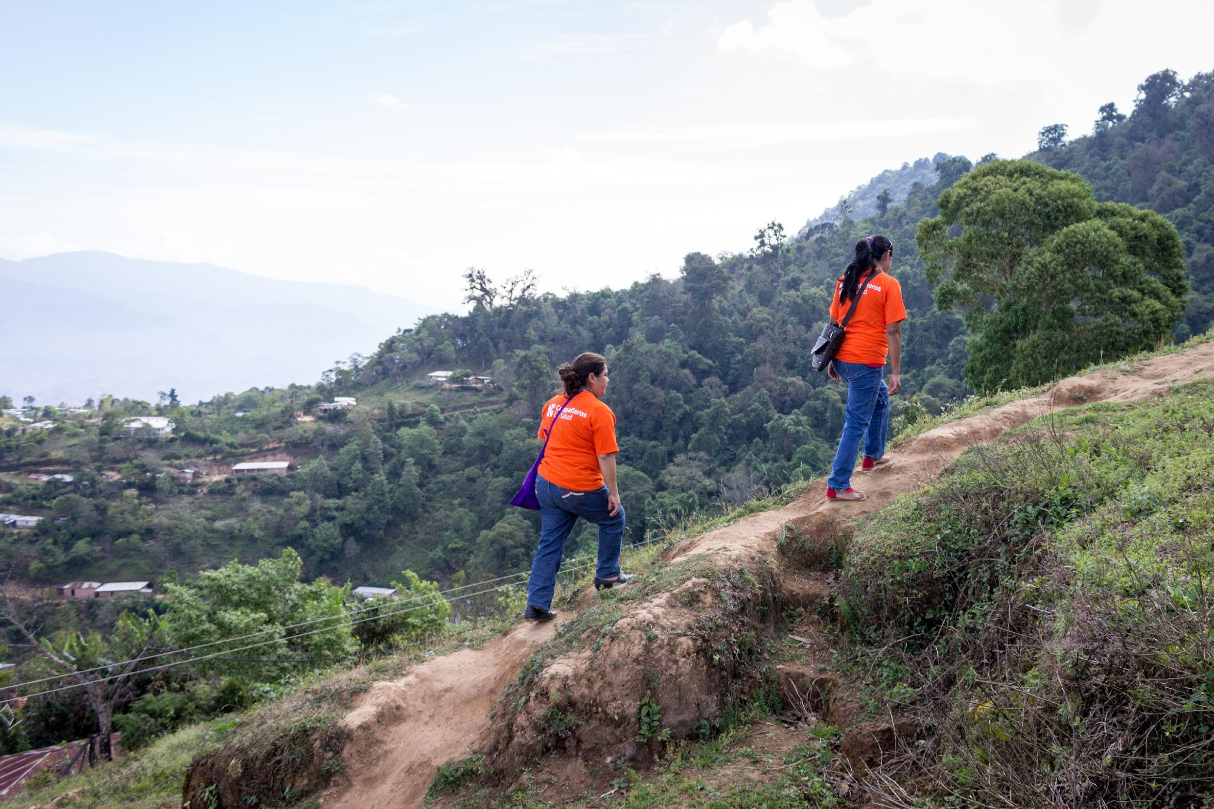
Background
Between February 2020 and mid-August 2022, Mexico reported nearly 7.2 million confirmed COVID-19 cases and over 342,000 deaths.
Mexico was the country with the second highest rate of excess mortality due to the COVID-19 pandemic for the period January 2020 to December 2021, with 325 estimated deaths per 100,000 inhabitants.
People living in already marginalized areas is more likely to present with severe symptoms of COVID-19 disease.
Chiapas, the poorest state in Mexico, has suffered disproportionately from the ongoing health emergency; it has experienced an exacerbation of pre-existing shortages of health professionals, medical supplies, and beds.
In this context, SARS-CoV-2 infection prevention and control interventions that can reduce the number of cases, especially among high-risk patients who are more likely to require hospitalization, are critically important.
CONACYT - CentroGeo - GeoInt - DataLab. COVID-19 Tablero México. 2022.
Ortiz-Hernández L, Pérez-Sastré MA. Inequidades sociales en la progresión de la COVID-19 en población mexicana. Rev Panam Salud Pública. 2020.

Slide 27
Background
In March 2020, Compañeros En Salud implemented a community health worker (CHW)-led contact tracing intervention in eight rural communities of the Fraylesca and Sierra Mariscal regions.
For all patients in eight outpatient clinics who met the Mexican MoH definition for a suspected COVID-19 case and their contacts who accepted the intervention.
All data were recorded in a CommCare-based mobile app.
Mar 2020
Sep 2020
Oct 2020
Mar 2021
1st COVID case in Chiapas
45 CHWs assigned to support contact tracing
CHWs receive PPE and training on contact tracing
Paper-based data collection entered in a CommCare app by CHW supervisor
CHWs begin entering data directly into the App
10 dedicated CHWs assigned to support contact tracing and receive additional incentives
New version of the contact tracing app ease digital data collection by CHWs
New algorithm for contact follow-up
New version of contract tracing app launched to accommodate new follow-up schedule for contacts

Slide 28
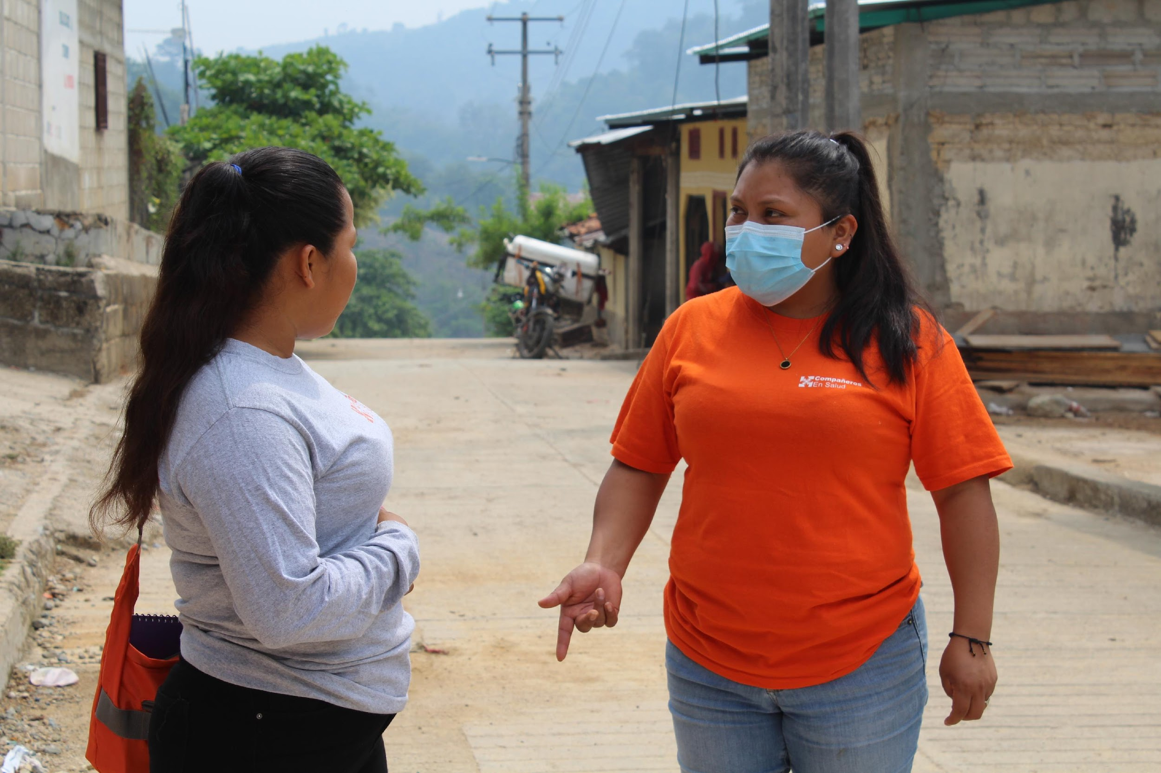
Methodology
In this study we documented the implementation and evolution of the intervention and assessed a)the evolution of two process indicators (contact tracing coverage and successful completion of contact tracing) and one outcome indicator (incidence of suspected COVID-19 among contacts) using descriptive statistics and b)their association with demographic characteristics of contacts and the intervention period using inferential statistics (univariate and multivariate logistic regression).

Slide 29
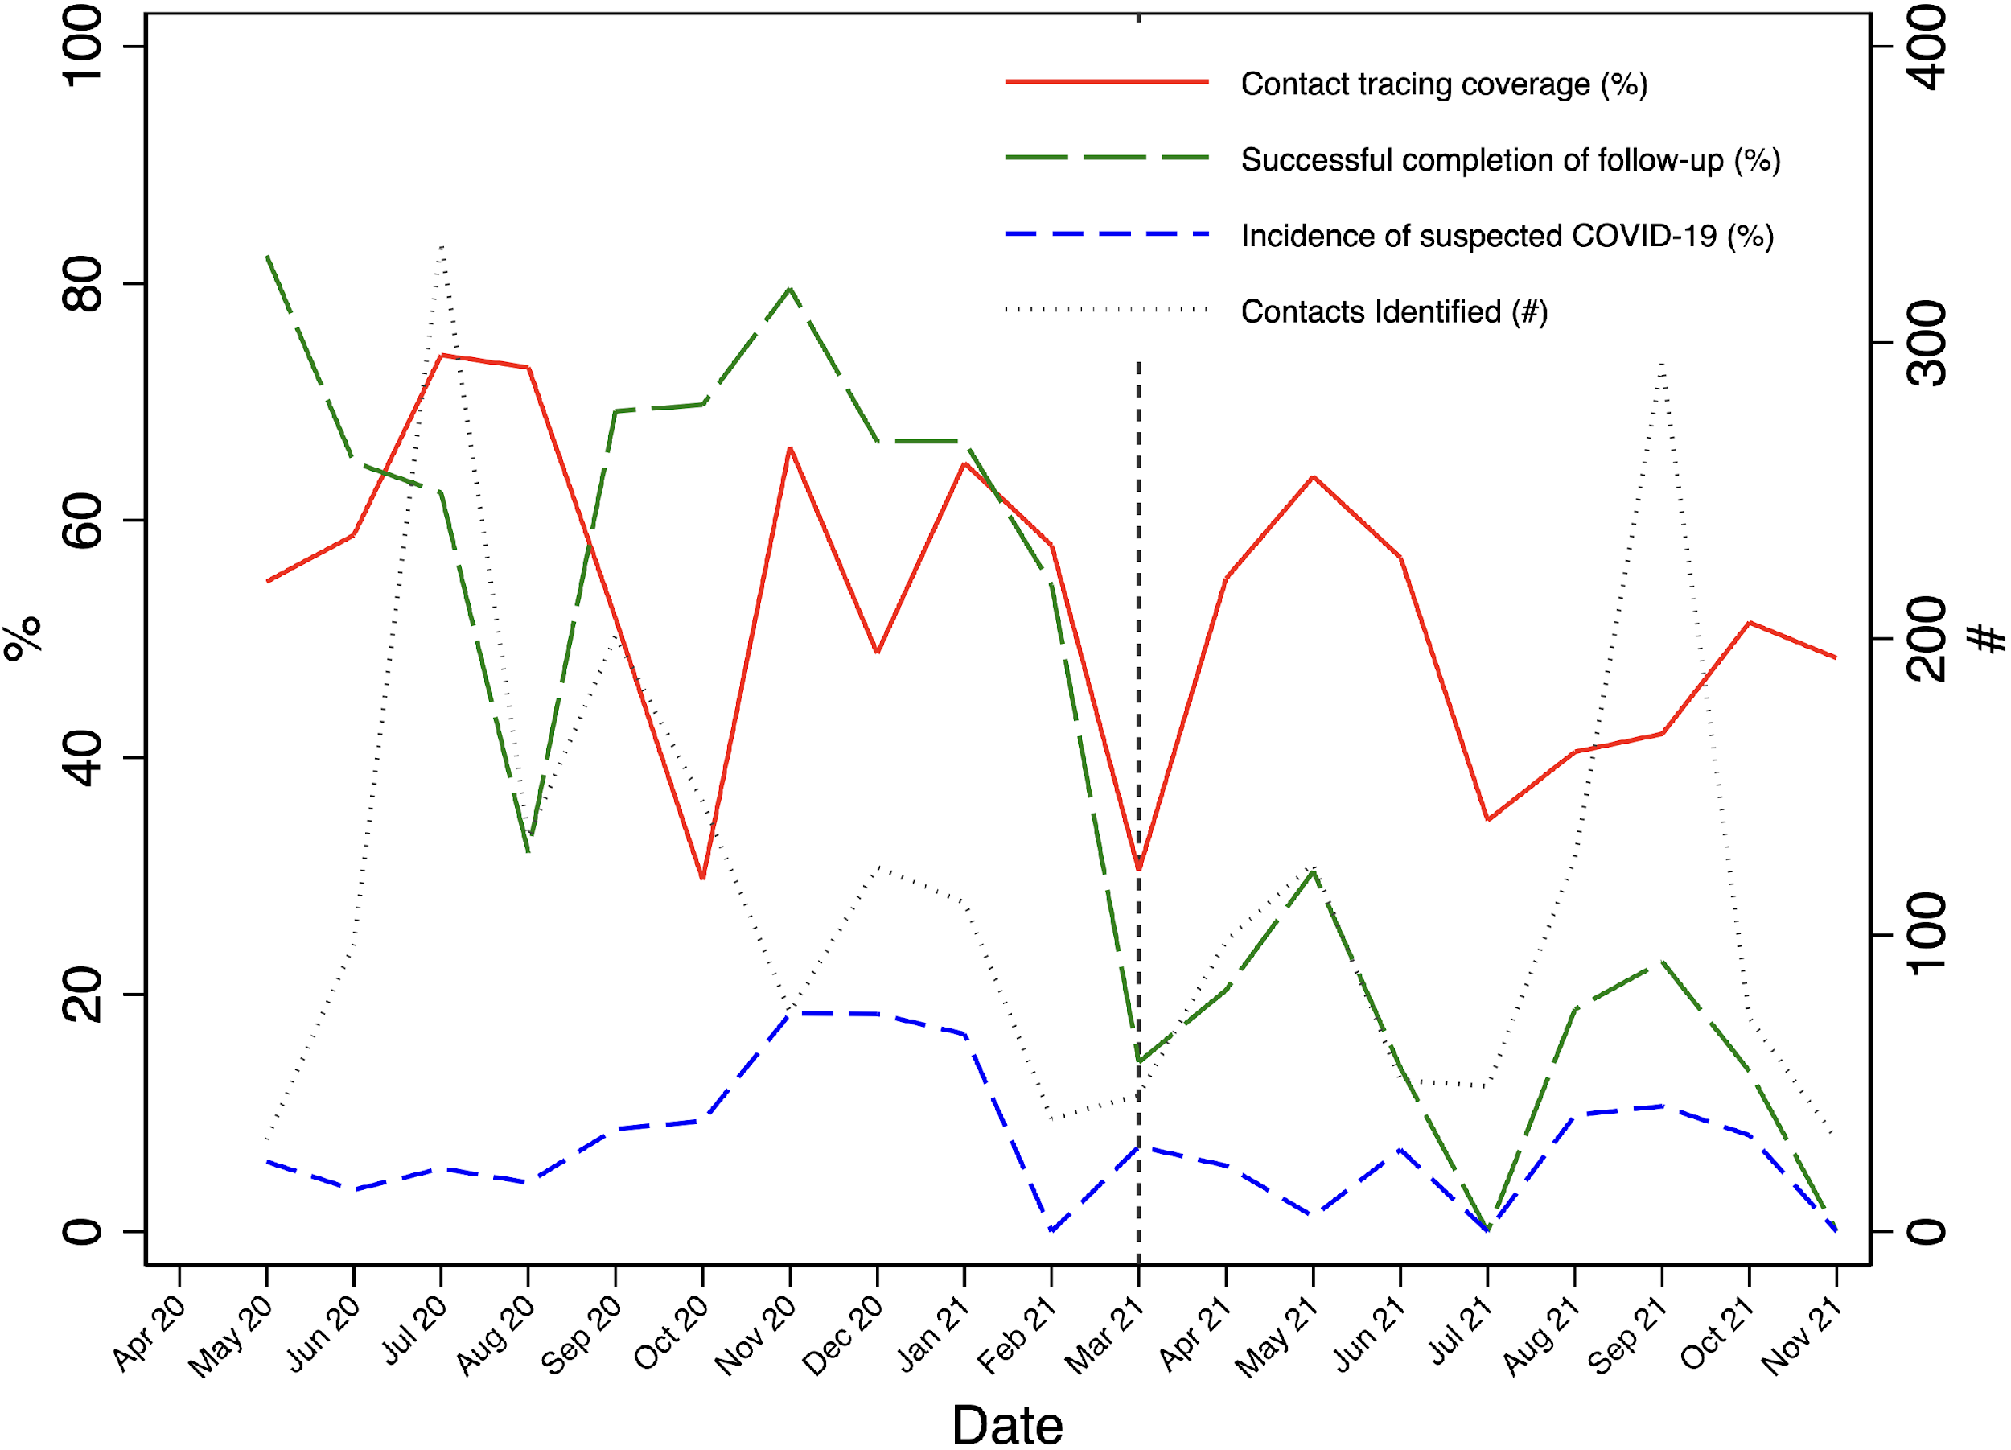
Results
From a roster of 2,177 named contacts, 1,187 (54.5%) received at least one home visit by a CHW and 560 (25.7%) had successful completion of contact tracing according to intervention guidelines.
Of 560 contacts with complete contact tracing, 93 (16.6%) became suspected COVID-19 cases.
We observed significant associations between sex and coverage (p = 0.006), sex and complete contact tracing (p = 0.049), community of residence and complete contact tracing (p = 0.005), and intervention period and both coverage and complete contact tracing (p < 0.001).
Evolution of the Compañeros En Salud-contact tracing intervention outcomes from April 2020 to November 2021.

Slide 30
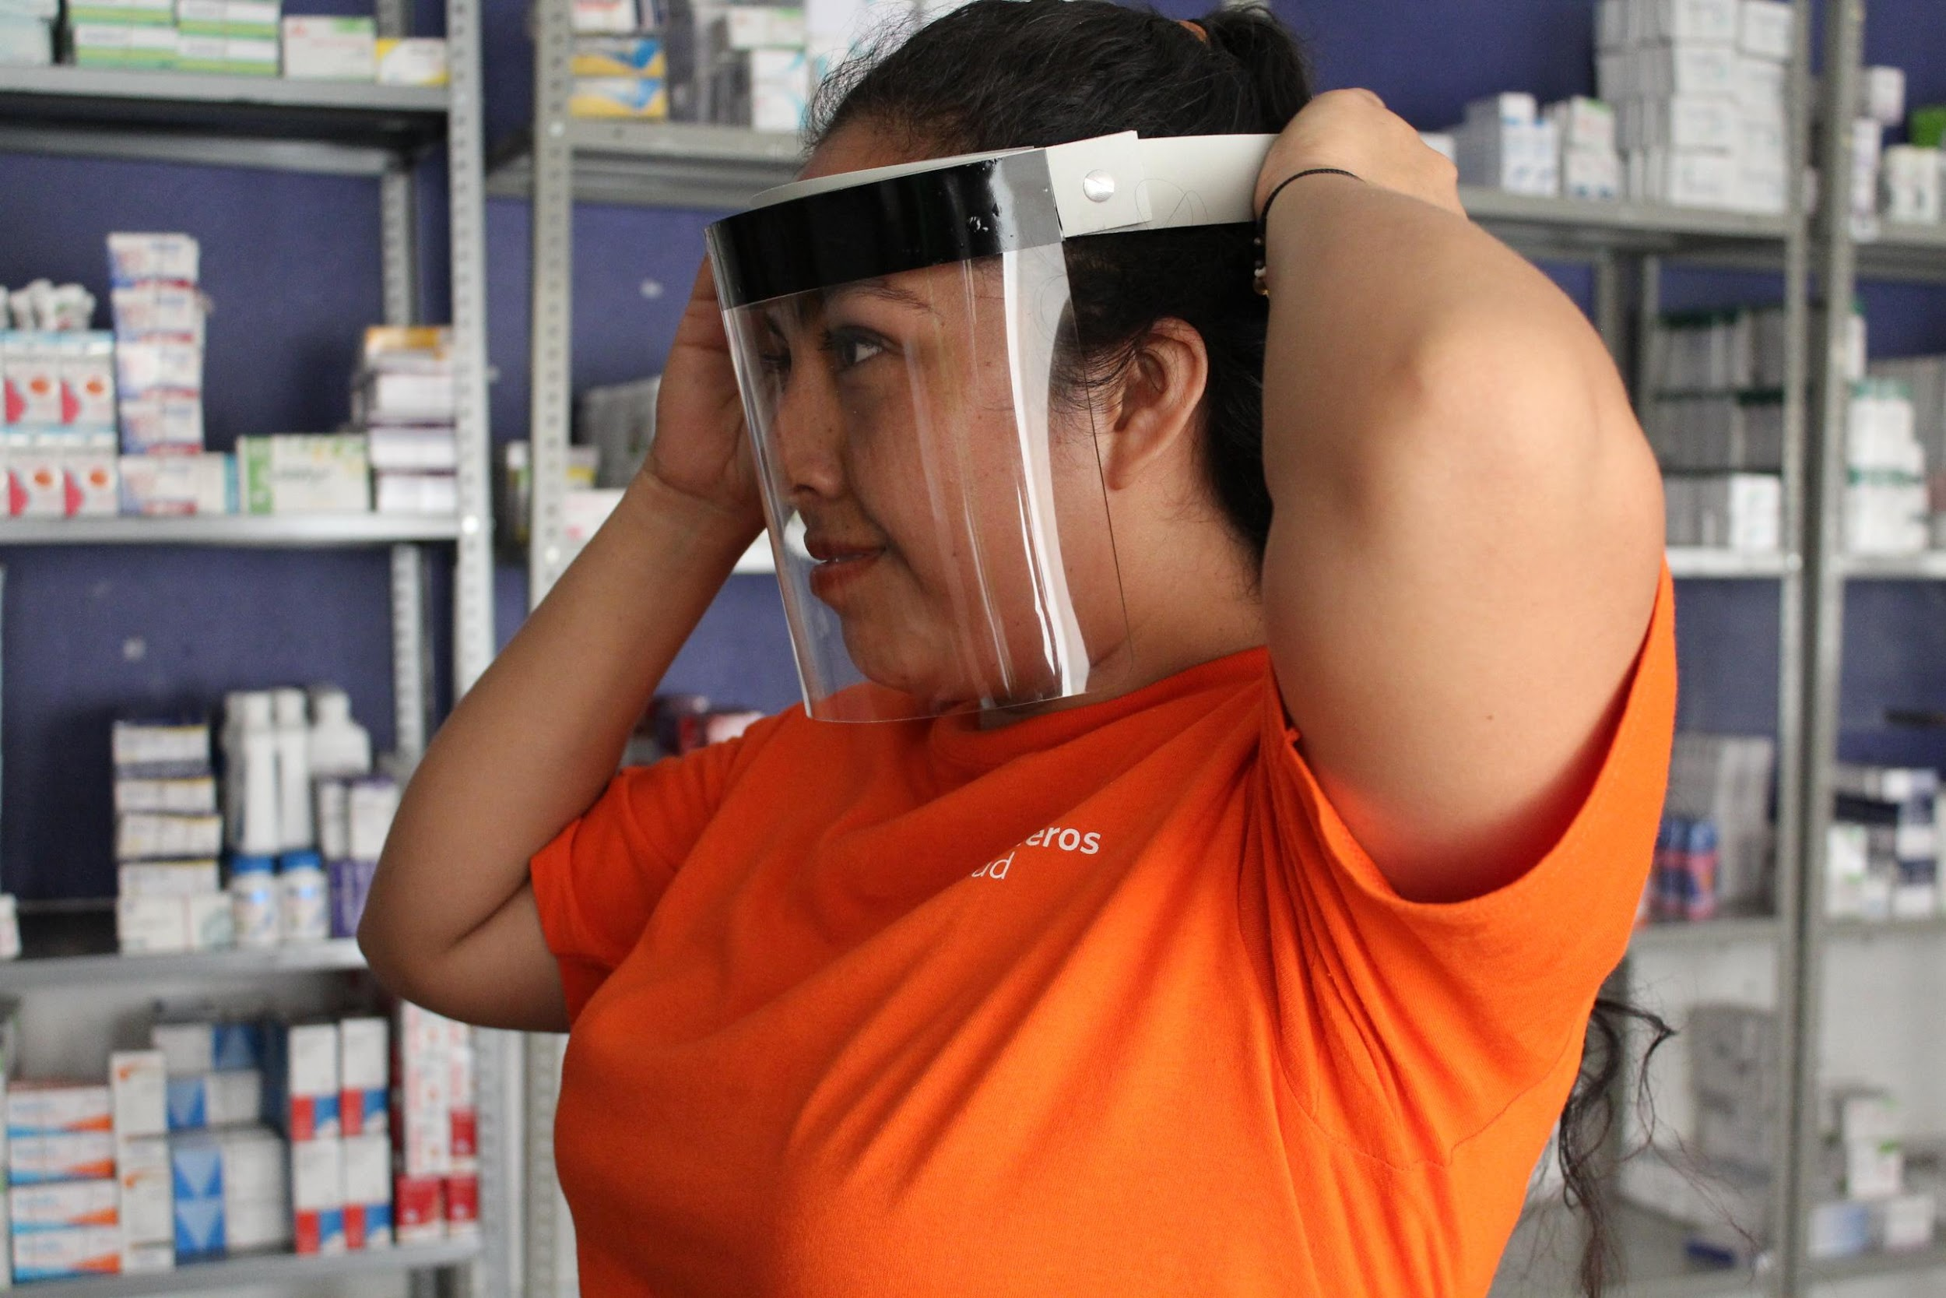
Discussion
Although we observed statistically significant differences between genders, contact tracing coverage and successful completion were less than 60% for both genders, pointing to a need for general programmatic strengthening.
Coverage was lower than in other contact tracing interventions involving CHWs worldwide (71-100%).
Successful completion was also lower than in other interventions (89-100%).
Incidence of suspected COVID-19 among contacts was similar to other contact tracing interventions (in Uganda, Nigeria, and the US), but much higher than in Rwanda (2%) and lower than in Oman (45%).
Implementation barriers:
Extremely limited telephone and internet connection. In-person contact tracing is more time-consuming and dangerous than remote contact tracing.
Lack of sufficient training and supervision of CHWs conducting contact tracing may have negatively affected the intervention outcomes.
Lack of community engagement during the intervention design and implementation.
Al Manji A, Tahoun M, Chi Amabo F, Alabri M, Mahmoud L, Al Abri B, et al. Contact tracing in the context of COVID-19: a case study from Oman. BMJ Glob Heal. 2022.
Nachega JB, Atteh R, Ihekweazu C, Sam-Agudu NA, Adejumo P, Nsanzimana S, et al. Contact Tracing and the COVID-19 Response in Africa: Best Practices, Key Challenges, and Lessons Learned from Nigeria, Rwanda, South Africa, and Uganda. Am J Trop Med Hyg. 2021.
Lash RR, Moonan PK, Byers BL, Bonacci RA, Bonner KE, Donahue M, et al. COVID-19 Case Investigation and Contact Tracing in the US, 2020. JAMA Netw Open. 2021.

Slide 31
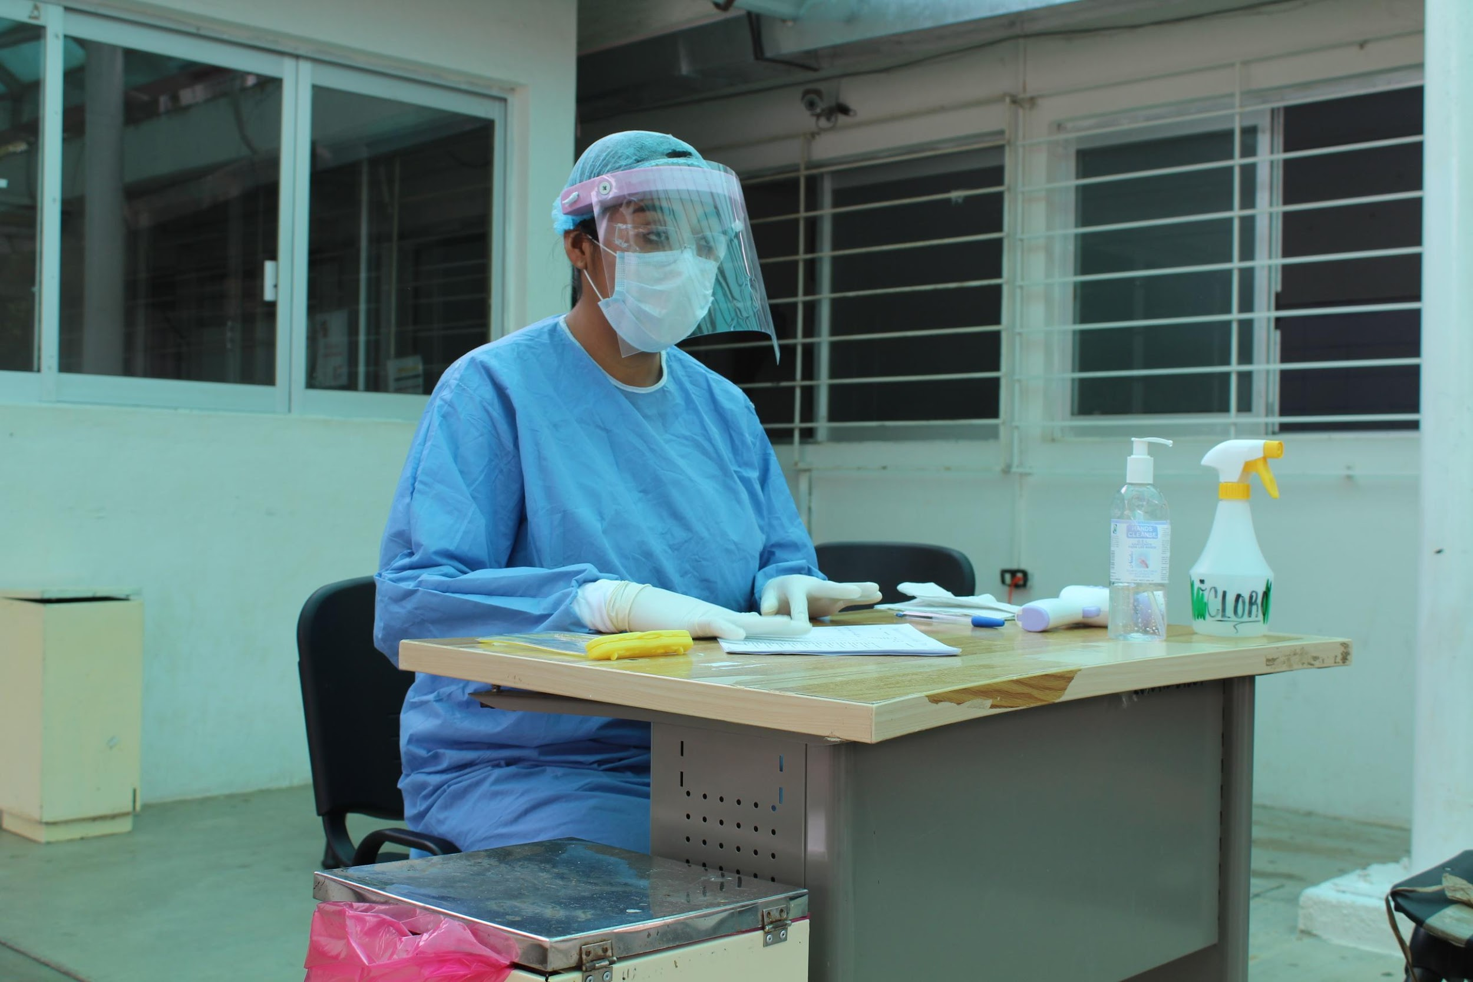
Conclusion
To our knowledge, our study is the first data-driven evaluation in Latin America of a CHW-led COVID-19 contact tracing intervention.
Our in-depth, data-based assessment of implementation challenges underscores the importance of early and ongoing evaluation of these programs to detect pitfalls that may be limiting the effectiveness of interventions, which is particularly relevant when resources are limited, as they can inform more optimal use of existing resources.

Slide 32
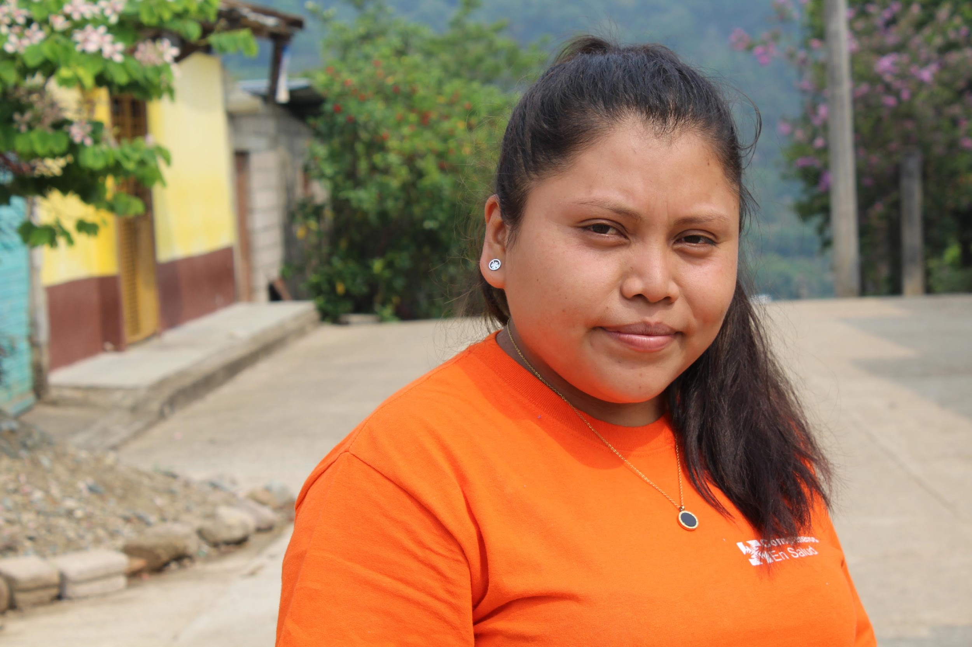
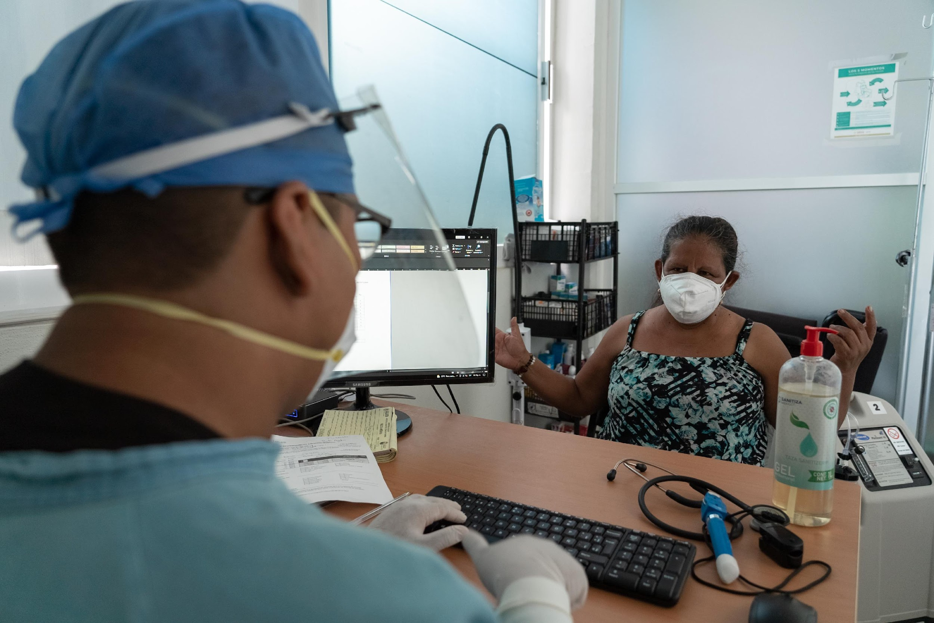
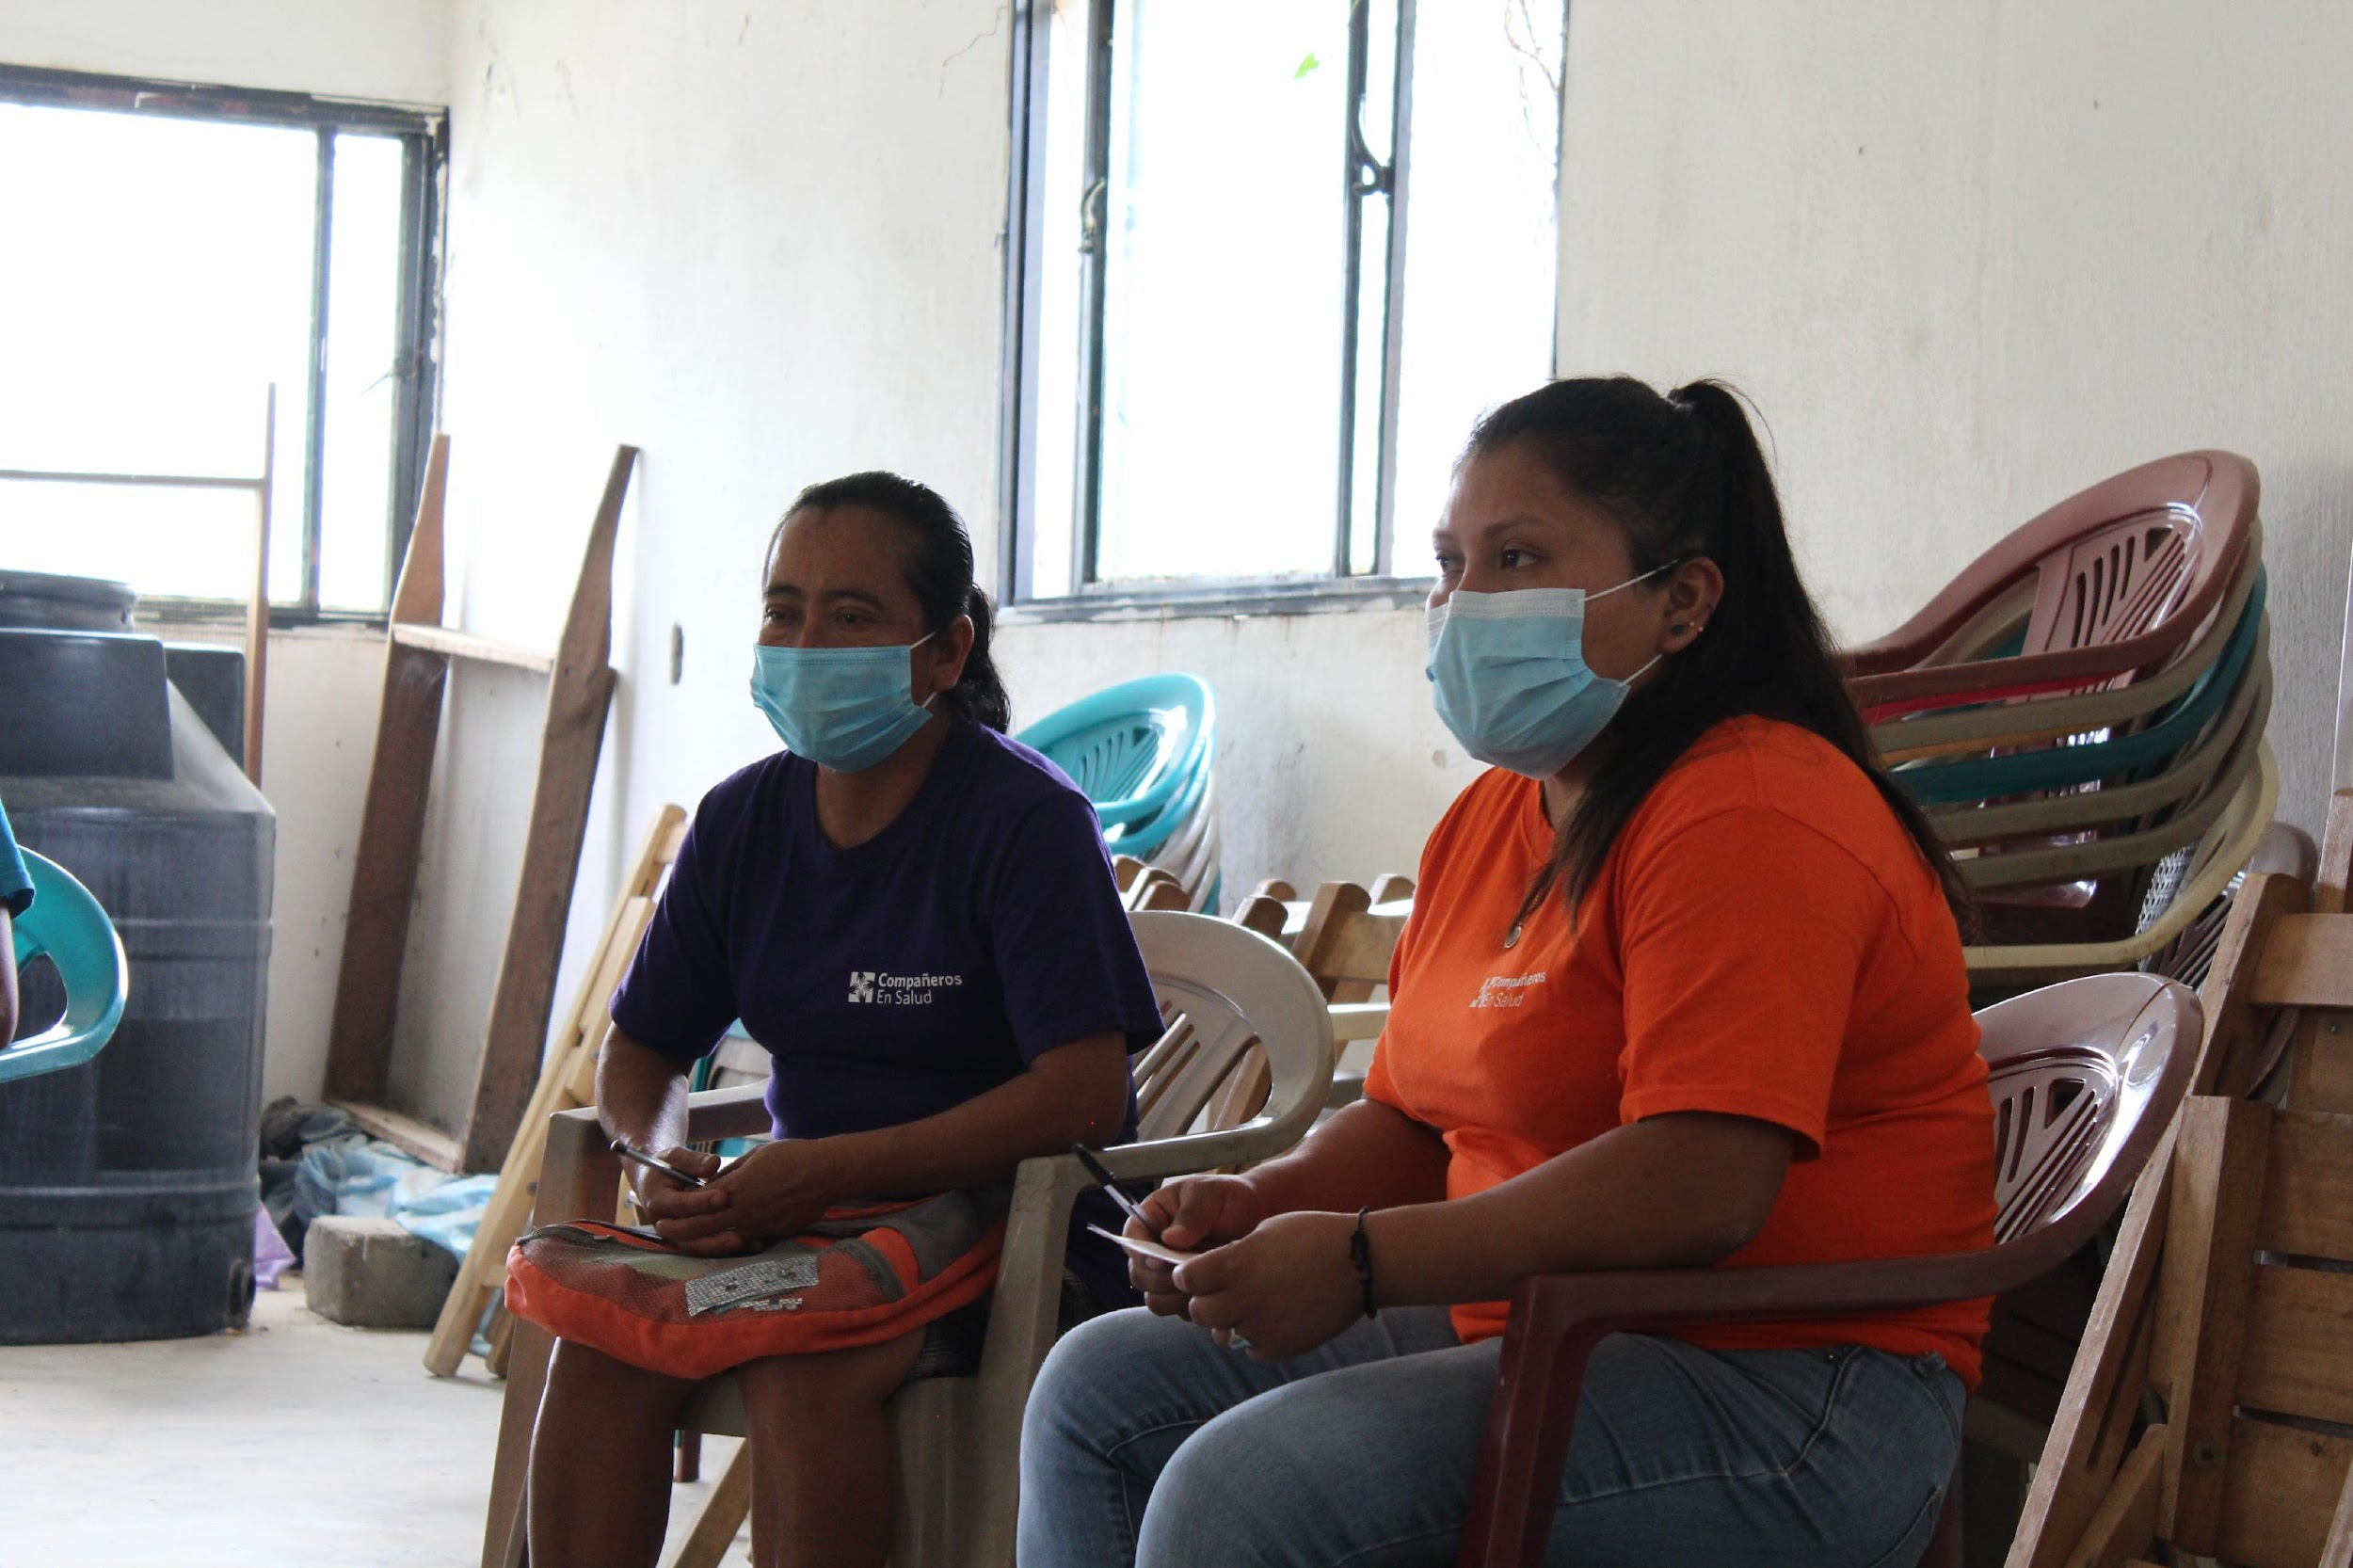
¡GRACIAS POR SU ATENCIÓN!
Zeus Aranda Remon
Coordinador de Investigación e Impacto, Compañeros En Salud
zaranda@pih.org
To submit Q&A questions, go to www.menti.com & enter code 5535 6338

Slide 33
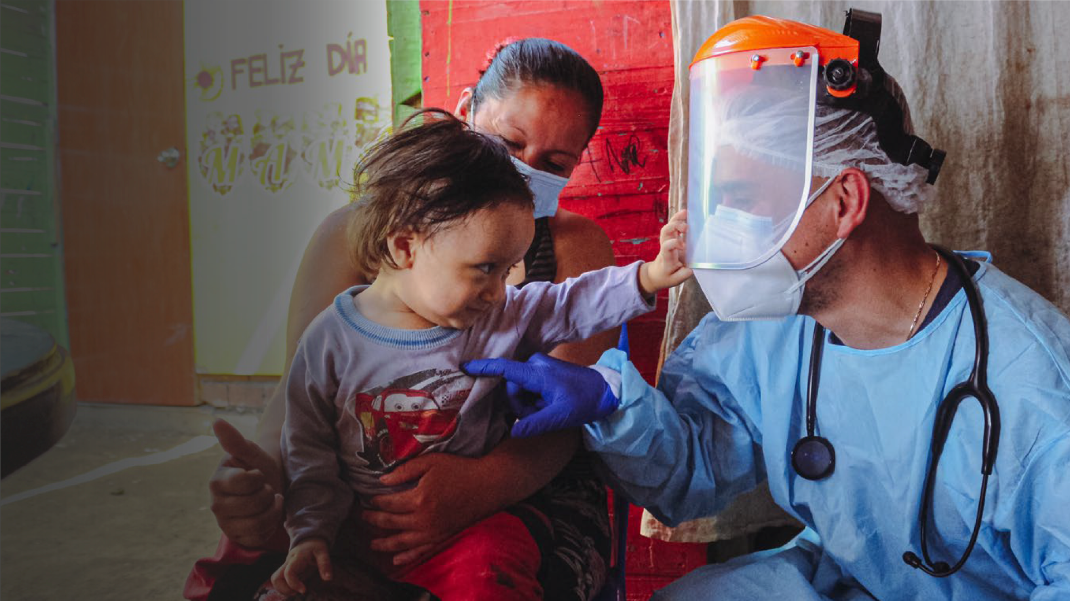


Slide 34

Seroprevalence of SARS-CoV-2 infection in Carabayllo, Lima Peru
Dr. Marco Tovar
Director Médico, Socios En Salud

Slide 35
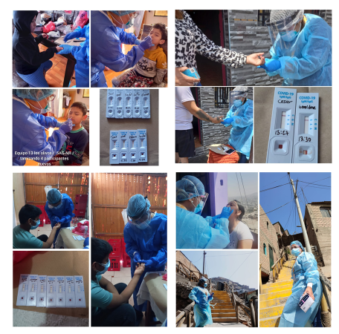
Introduction
Serological surveillance provides estimates of population-level immunity against infectious diseases using cross-sectional studies of antibody prevalence
In Perú, one surveillance in Lambayeque was done in June 2020 showed 29.5% of seroprevalence,[1] another one in Iquitos estimated a seroprevalence of 70% (IC 95%: 67-73) in July 2020 and 66% (95% IC: 62-70) at August 2020(12).[2] The largest seroprevalence study of SARS-CoV-2 in Lima showed 20.8% (95% IC: 17,2-23,5). [3]
To inform policy makers of DIRIS Lima North (dependence on MoH), we did cross-sectional, observational serosurvey study conducted between November and December 2020 in the district of Carabayllo to evaluate the seroprevalence of SARS-CoV-2 infection.
1. Diaz-Velez, C., et al., SARS-CoV-2 seroprevalence study in Lambayeque, Peru. June-July 2020. PeerJ, 2021. 9: p. e11210.
2. Alvarez-Antonio, C., et al., Seroprevalence of anti-SARS-CoV-2 antibodies in Iquitos, Peru in July and August, 2020: a population-based study. Lancet Glob Health, 2021. 9(7): p. e925-e931.
3. Reyes-Vega, M.F., et al., SARS-CoV-2 prevalence associated to low socioeconomic status and overcrowding in an LMIC megacity: A population-based seroepidemiological survey in Lima, Peru. EClinicalMedicine, 2021. 34: p. 100801.

Slide 36
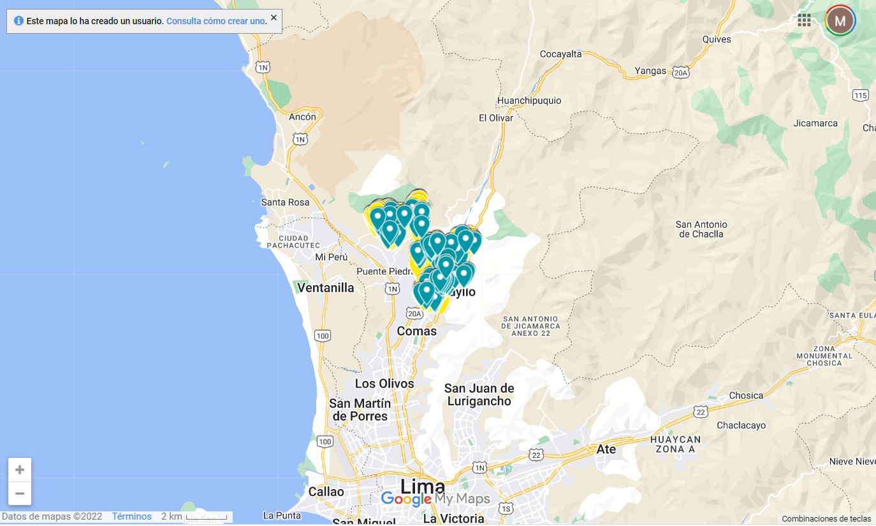
Methodology
The sampling scheme was designed to represent the entire Carabayllo population. The observational serosurvey study was conducted between November and December 2020.
SARS-CoV-2 IgM and IgG antibodies were tested using STANDARD Q COVID-19 IgM/IgG Duo Test by fingerpick as indicated by the manufacturer.

Slide 37
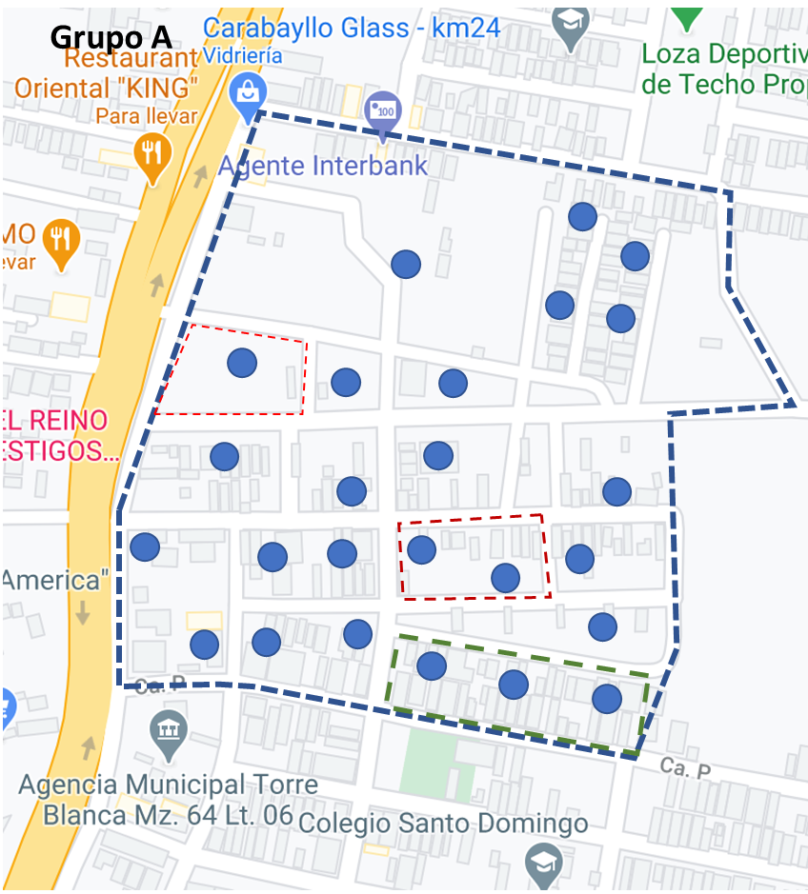
Methodology
We used Carabayllo maps from Google Maps Platform (reference: https://mapsplatform.google.com), using licensed ArcGIS Pro version 10.3 (reference: https://www.esri.com/en-us/arcgis/products/arcgis-pro/overview).
We defined equal-size clusters in the Carabayllo map, in each cluster we make sure that it has a minimum of 10 blocks and a maximum of 16 blocks of houses, for each block of houses up to three locations were manually selected using ArcGIS, obtaining up to 35 locations from each cluster

Slide 38
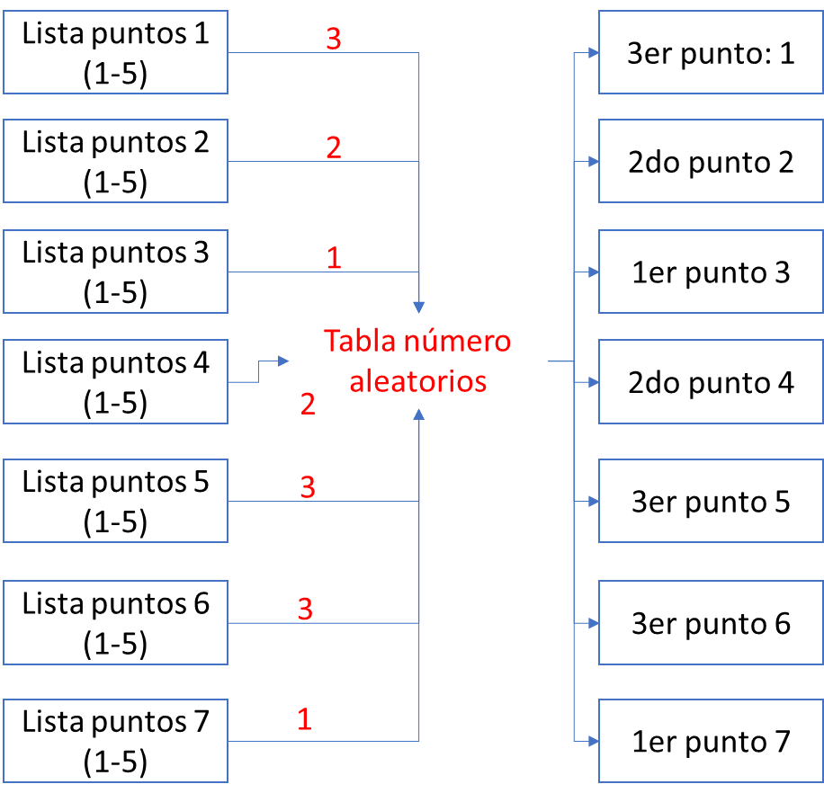
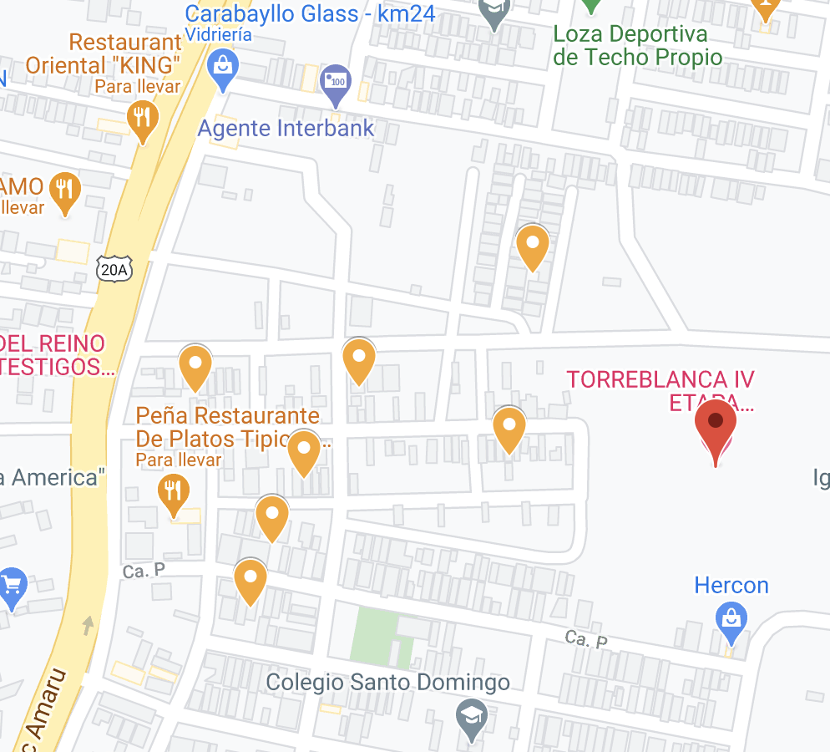
Methodology
A table of random numbers only 7 locations were selected of each cluster: 5 were to visit and 2 were backup in case any of the 5 locations is not possible to visit, the use of the 2 locations was in case it is not a dwelling, it is a dwelling but there are no inhabitants or there is one housing, inhabitants but do not want to be evaluated.

Slide 39
Methodology
We estimated the proportion of individuals who had a positive result for either IgG and/or IgM by calculating weights to ensure the age and sex distribution of the study participants matched the population of Carabayllo (Table 1).
To compare adjusted seropositivity across demographic and clinical characteristics, we estimated the prevalence ratio using generalized linear mixed models with a random intercept to account for household clustering.
We also provide overall seroprevalence estimates adjusted for imperfect accuracy of the antibody test using the method proposed by Diggle.[4] Specifically, we utilize the specificity estimate (95.1%) and sensitivity estimates based on date of symptom onset (68.9%-99.1%) reported in the STANDARD Q COVID-19 IgM/IgG Duo Test pamphlet. [5]
We performed all data analysis using the statistical software Stata version 15.0 (Stata Corp LP, College Station, Texas).
4. Diggle, P.J., Estimating Prevalence Using an Imperfect Test. Epidemiology Research International, 2011. 2011: p. 608719.
5. Avantika. SD Biosensor COVID-19 [Internet]. 2020. p. 1–2. Available from: www.sdbiosensor.com

Slide 40
Resultados
Table 1: Distribution of sex and age for the source and study population
Figure 1: Flow chart
Females were slightly overrepresented in the study population, but the age distributions within each gender are similar

Slide 41
Resultados
Table 2: Seroprevalence estimates by various sensitivity estimates from the STANDARD Q COVID-19 IgM/IgG Duo Test
Notes:
After weighting the study participants to match the age-sex distribution of Carabayllo, the seroprevalence of SARS-CoV-2 infection (presence of IgG and/or IgM antibodies) for the Carabayllo community in this period was 24.99% (22.51% - 27.72%).

Slide 42
Resultados
Table 3: The proportion of infected individuals stratified by sex and age

Slide 43
Resultados
Table 4: The proportion of individuals infected by SARS-CoV-2 stratified by presence of symptoms

Slide 44
Limitations
It is possible that some persons infected were not identified during the serosurvey due to delayed seroconversion due to a recent SARS-CoV-2 infection or seroreversion due to waning antibody response.
Nevertheless, our sampling scheme as opposed to convenience estimates decreases these issues.
Conclusions
The study shows that the proportion of people with evidence of infection in this population after the first wave is low compared to that reported in other studies.
At the same time, the results indicate that there is a large susceptible population that could be affected again, while there was no access to the vaccine that could be complemented maintained other infection control measures.

Slide 45

To submit Q&A questions, go to www.menti.com & enter code 5535 6338

Slide 46
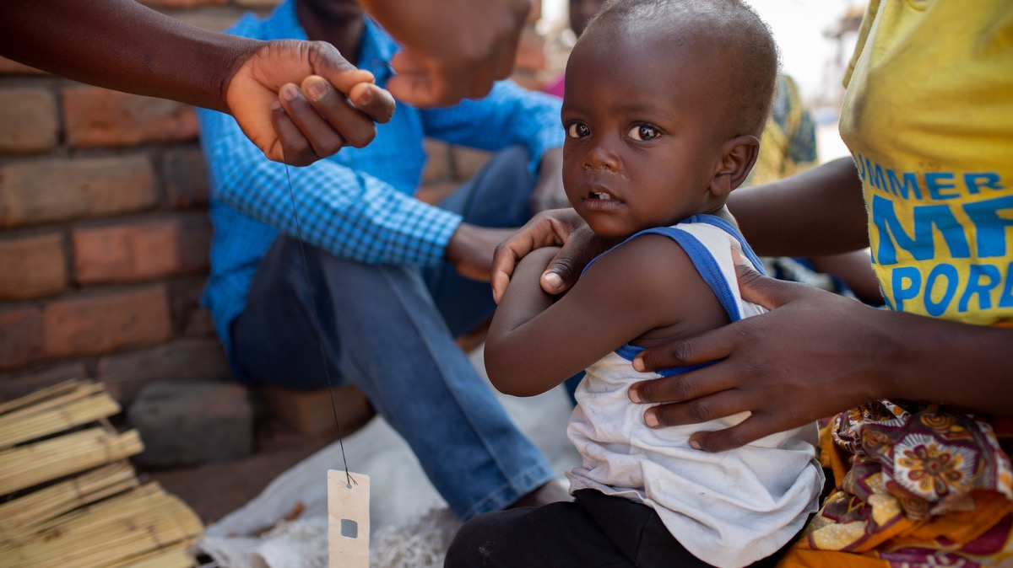
Childhood immunization during the COVID-19 pandemic: experience in Haiti, Lesotho, Liberia and Malawi
Emilia Connolly DO MPH
Health Systems Research | November 2022

Slide 47
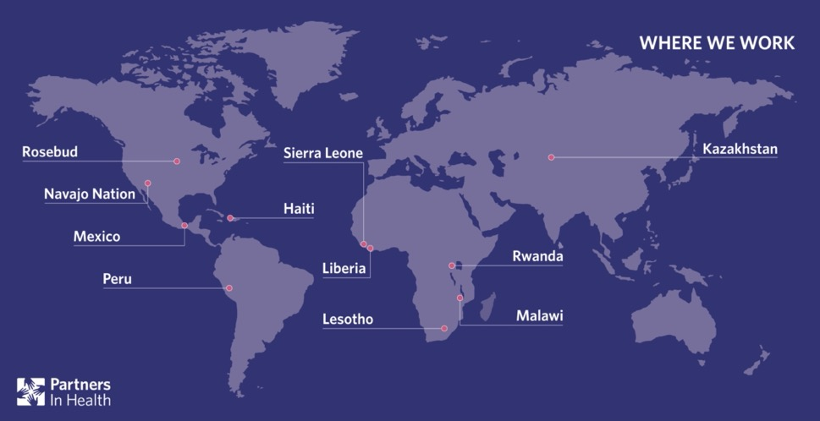
AUTHOR ACKNOWLEDGEMENT
Emilia Connolly,ª Emma J Boley,^{b} Donald Luke Fejfar,^{c} Prince F Varney,^{b} Moses B Aron,ª Isabel R Fulcher,^{d} Wesler Lambert,^{e} Melino Ndayizigiye,^{f} Michael R Law,^{g} Jean-Claude Mugunga^{c} & Bethany Hedt-Gauthier^{d} on behalf of the Cross-site COVID-19 Syndromic Surveillance Working Group
ª Partners In Health, P.O. Box 56, Neno, Malawi.
^{b} Partners In Health, Monrovia, Liberia.
^{c} Partners In Health, Boston, United States of America (USA).
^{d} Department of Global Health and Social Medicine, Harvard Medical School, Boston, USA.
^{e} Partners In Health, Port au Prince, Haiti.
^{f} Partners In Health, Maseru, Lesotho.
^{g} School of Population and Public Health, University of British Columbia, Vancouver, Canada.
Correspondence to Emilia Connolly (email: econnolly@pih.org).

Slide 48
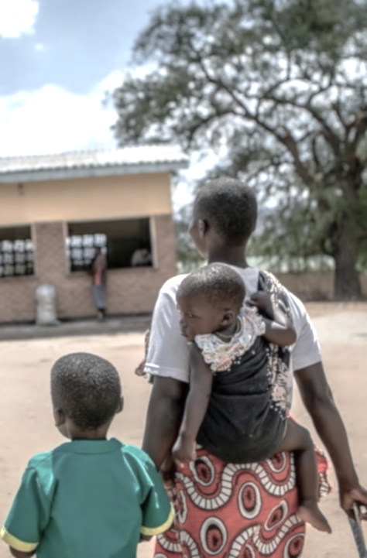
INTRODUCTION
COVID-19 pandemic interrupted essential services such as immunizations¹
Early pandemic models predicted severe interruptions and resulting increased mortality^{2,3}
Mitigation measures had unintended effects on health service delivery^{4,5}
Gaps in sustained monitoring beyond initial prevention measures
Hartley and Perencevich 2020
Abbas et al 2020
Roberton et al. 2020
Haider et al 2020
WHO Pulse survey 2020
Notes:
Already inequitable coverage before pandemic in LMIC due to inadequate health infrastructure, insufficient
human resources and supply chain disruptions. People living in the poorest households and in remote areas are least likely to have optimal vaccination coverage and uptake.5 Prior health emergencies such as H1N1 influenza and Ebola epidemics lead to secondary disease outbreaks.
One model predicted that for every one excess COVID-19 death acquired during visits for routine vaccination, 84 deaths could be prevented by sustaining routine childhood immunization in Africa.10 (Abbas K, et al. Routine childhood immunisation during the COVID-19 pandemic in Africa: a benefit-risk analysis of health benefits of routine childhood immunization against the excess risk of SARS-CoV-2 infections during the COVID-19 pandemic in Africa. Lancet Glob Health. 2020 http:// dx .doi .org/ 10 .1016/ S2214 -109X(20)30308 -9 PMID: 3268779)
Mitigation measures - For example, of 105 countries included in the World Health Organization (WHO) pulse
survey in mid-2020, 50% reported partial disruptions and 10% reported severe disruptions in facility-based immunizations.15
Important gaps in the literature exist, including limited sustained monitoring beyond initial prevention measures, no on-the-ground investigations in low- and middle-income countries outside Asia and little investigation within specific populations at risk. 2 studies at the time with rebounds in coverage with catch up campaigns and lifting of social distancing measures in the US and the Netherlands.

Slide 49
OBJECTIVE
To examine changes in vaccination of children younger than 1 year during the COVID-19 pandemic (March 2020-August 2021) in Haiti, Lesotho, Liberia and Malawi
Allowed for investigation in varied geographic regions with different populations and mitigation measures and their practical application at local level
4 countries, 10 districts, 41 facilities and 6.4 million people
Allowed us to investigate potential ways to maintain immunization programmes and other essential services during acute health crises

Slide 50
METHODS
Utilized negative binomial regression modeling⁶ from existing routine health information systems
Accounted for early and seasonal trends with historical data from Jan 2016 to Feb 2020*
Utilized models to extrapolate expected immunization counts without the pandemic with 95% confidence intervals
Reported cumulative difference in number of vaccinations and percent difference during three periods in the pandemic: Early (Mar-Aug 2020), Middle (Sep 2020-Feb 2021), Late (Mar-Aug 2021) with Total (Mar 2020-Aug 2021)
Analysis and visualizations done in R v4.0.4
Exclusions
Missing data for more than 20% baseline months or vaccine dose was missing data for any months in evaluation period (fit model assuming the data were missing at random)
301 facility indicator combinations, 8 (2.7%) were excluded
*Except for Haiti which started from January 2017
Fulcher et al. 2021

Slide 51
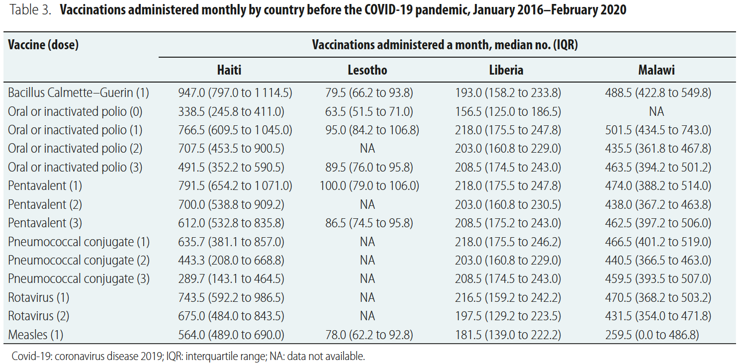
BASELINE DATA
Notes:
Immunization vaccine-dose combinations – considered 14 vaccine-dose combinations for children <1 year old as seen in the table. Pentavalent vaccines contains hepatitis B, Haemophilus influenza type B and Dipththeria-tetanus and perfussis). We report results for each vaccine dose by country; some combinations
are not included for specific countries, as you can see with the NA nonapplicable. We grouped vaccines into five classes based on age at administration: at birth, at 6 weeks, at 10 weeks, at 14 weeks and at 36 weeks.
Lesotho had lowest number of monthly vaccinations from 63.5 for the first dose of Polio to 100 for pentavalent #1
Haiti had the highest number of vaccines from 289.7 pneumococcal dose 3 to 947 BCG vaccines administered per month

Slide 52
RESULTS
Overall Vaccination Deficits
March 2020 – August 2021
All countries except Libera had a cumulative deficit for the 14 dose combination
Only significant for rotavirus doses 1 and 2 in Liberia and all vaccine-dose combinations in Malawi
March – August 2020
Declines except for Malawi
Statistically significant drops in measles for Haiti, Lesotho & Liberia with ending upward trend
Sep 2020 – February 2021
Most returned to expected levels with decreases at the end of the period
Country | Cumulative % Difference
Haiti | 5.1% (-16.8% to 19.9%)
Lesotho | 5.9% (-16.3% to 10.1%)
Liberia | 8.0% (-21.1% to 15.9%)
Malawi | 2.0% (-14.1% to 12.6%)
March – August 2021
Returned to expected or above in Malawi
May to August with decreases in Malawi & Liberia

Slide 53
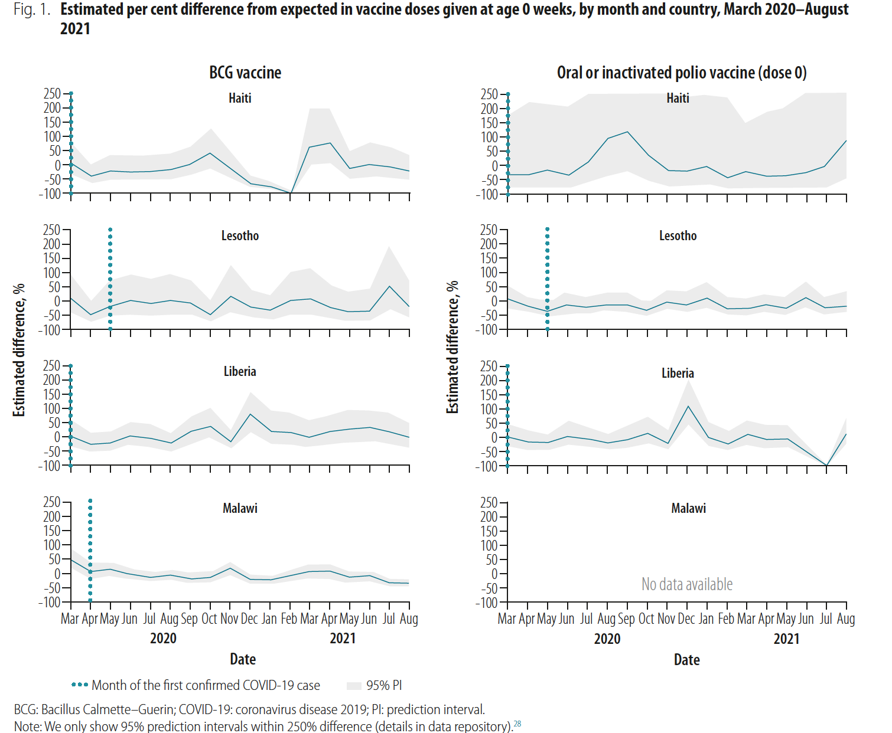
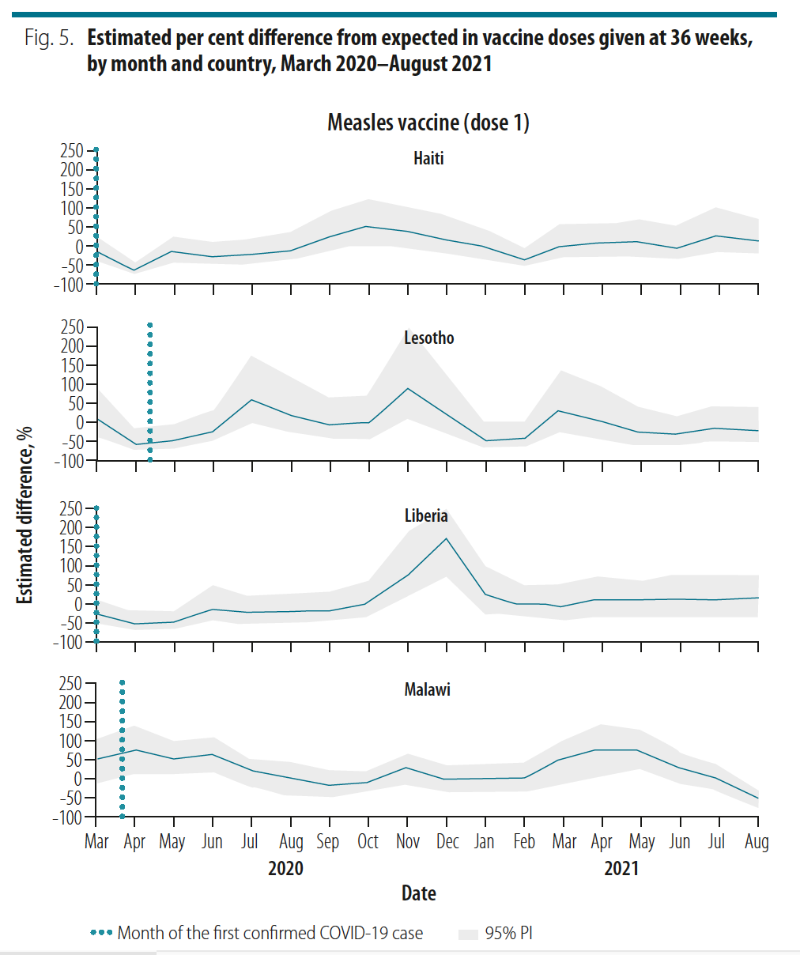
SELECTED RESULTS REVIEW
STOCKOUTS
Variation In Pandemic Waves
COMMUNITY OR CATCH UP CAMPAIGN

Slide 54
DISCUSSION
Initial declines were observed in Europe^{10,11}, North America¹² and Asia¹³ in early 2020 with only recent information for Africa¹⁴⁻¹⁶
Now studies are observing rebounds consistently and dependent on waves of infection¹⁴⁻¹⁶
Variations complex and varied by country and even by district
More pronounced declines with older age of child
Importance of community health awareness, education and outreach
Now juggling with COVID-19 vaccine and other emergencies and outbreaks
Selected Feature | Haiti | Lesotho | Liberia | Malawi
COVID-19 Stringency index⁷*
Cumulative COVID-19 Cases per 1 million^{8,9^} | 1806 | 6667 | 1080 | 3073
Cumulative case fatality rate^{8,9}^ | 2.8% | 2.8% | 4.4% | 3.6%
Consistent Community outreach
*At beginning of the pandemic; all dropped by May 2021
^As of 31 August 2021
Hale et al. 2021
Dong et al. 2020
Our World in Data 2021
Middeldorp et al 2021
McDonald, et al. 2020
O’Leary et al. 2021
Zhong et al 2021
Hategeka et al 2021
Spencer et al 2020
Shet et al 2020
Notes:
Our study has several limitations.
data used from the District Health Information Software 2 are aggregated at the facility level. We cannot assess whether individual patients received all vaccines, if vaccinations were on time or delayed for a specific child, or if the catchment populations of the districts changed from the baseline period.
Possibility that the COVID-19 pandemic affected the timeliness and completeness of facility-level reporting, particularly during restrictions; however, Partners In Health teams provided additional logistical and technical resources to ensure continued timely data collection in these 10 districts.
data are limited to the 10 districts within the four countries; while this may limit generalizability, these results represent a broad geography not yet included in reports on the effect of the COVID-19 pandemic.
exclusion of facilities with more than 20% missing baseline data.
Avoid undercounting by excluding
However, it is important to emphasize that we excluded very few facilities because of having more than 20% missing data, with a maximum number of four facilities, out of 41 facilities, excluded for a single vaccine dose indicator.

Slide 55
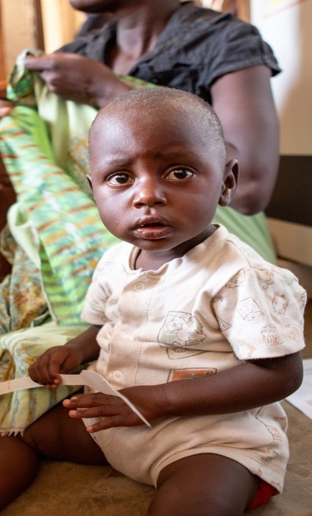
CONCLUSION
To ensure vaccine utilization rates are well maintained despite continued waves of COVID-19 and new outbreaks and emergencies, we need to:
Contextualize education and response within immediate communities and health systems with building capacity for health care staff
Strengthen efforts for educating communities and parents on COVID-19 and other outbreak risks and value of childhood vaccinations
Targeted community outreach clinics

Slide 56
REFERENCE
Hartley DM, Perencevich EN. Public health interventions for COVID-19: emerging evidence and implications for an evolving public health crisis. JAMA. 2020 May 19;323(19):1908–9. doi: http:// dx .doi .org/ 10 .1001/ jama.2020 .5910 PMID: 32275299
Abbas K, Procter SR, van Zandvoort K, Clark A, Funk S, Mengistu T, et al. Routine childhood immunisation during the COVID-19 pandemic in Africa: a benefit-risk analysis of health benefits of routine childhood immunization against the excess risk of SARS-CoV-2 infections during the COVID-19 pandemic in Africa. Lancet Glob Health. 2020 Oct;8(10):e1264–72. doi: http:// dx .doi .org/ 10 .1016/ S2214 -109X(20)30308 -9 PMID: 32687792
Roberton T, Carter ED, Chou VB, Stegmuller AR, Jackson BD, Tam Y, et al. Early estimates of the indirect effects of the COVID-19 pandemic on maternal and child mortality in low-income and middle-income countries: a modelling study. Lancet Glob Health. 2020 Jul;8(7):e901–8. doi: http:// dx.doi .org/ 10 .1016/ S2214 -109X(20)30229 -1 PMID: 32405459
Haider N, Osman AY, Gadzekpo A, Akipede GO, Asogun D, Ansumana R, et al. Lockdown measures in response to COVID-19 in nine sub-Saharan African countries. BMJ Glob Health. 2020 Oct;5(10):e003319. doi: http:// dx .doi .org/ 10 .1136/ bmjgh -2020 -003319 PMID: 33028699
Pulse survey on continuity of essential health services during the COVID-19 pandemic: interim report, 27 August 2020. Geneva: World Health Organization; 2020. Available from: https:// apps .who .int/ iris/ handle/ 10665/334048 [cited 2021 Mar 11].
Fulcher IR, Boley EJ, Gopaluni A, Varney PF, Barnhart DA, Kulikowski N, et al.; Cross-site COVID-19 Syndromic Surveillance Working Group. Syndromic surveillance using monthly aggregate health systems information data: methods with application to COVID-19 in Liberia. Int J Epidemiol. 2021 Aug 30;50(4):1091–102. doi: http:// dx .doi .org/ 10 .1093/ ije/ dyab094 PMID: 34058004
Hale T, Angrist N, Goldszmidt R, Kira B, Petherick A, Phillips T, et al. A global panel database of pandemic policies (Oxford COVID-19 Government Response Tracker). Nat Hum Behav. 2021 Apr;5(4):529–38. doi: http:// dx .doi.org/ 10 .1038/ s41562 -021 -01079 -8 PMID: 33686204
Dong E, Du H, Gardner L. An interactive web-based dashboard to track COVID-19 in real time. Lancet Infect Dis. 2020 05;20(5):533–4. doi: http:// dx .doi .org/ 10 .1016/ S1473 -3099(20)30120 -1 PMID: 32087114
Case fatality rate of COVID-19 [internet]. Oxford: Our World in Data; 2021. Available from: https:// ourworldindata .org/ explorers/ coronavirus -data-explorer ?zoomToSelection = true & time = 2020 -03 -14 .latest & facet = none & pickerSort = asc & pickerMetric = location & hideControls = true & Metric = Case+fatality+ rate & Interval = Cumulative & Relative+ to+ Population = false & Align+outbreaks = true & country = MWI ~LBR ~LSO ~HTI [cited 2021 Oct 23].
Middeldorp M, van Lier A, van der Maas N, Veldhuijzen I, Freudenburg W, van Sorge NM, et al. Short term impact of the COVID-19 pandemic on incidence of vaccine preventable diseases and participation in routine infant vaccinations in the Netherlands in the period March–September 2020. Vaccine. 2021 Feb 12;39(7):1039–43. doi: http:// dx .doi .org/ 10 .1016/ .vaccine .2020 .12 .080 PMID: 33478793
McDonald HI, Tessier E, White JM, Woodruff M, Knowles C, Bates C, et al. Early impact of the coronavirus disease (COVID-19) pandemic and physical distancing measures on routine childhood vaccinations in England, January to April 2020. Euro Surveill. 2020 May;25(19):2000848. doi: http:// dx .doi .org/10 .2807/ 1560 -7917 .ES .2020 .25 .19 .2000848 PMID: 32431288

Slide 57
REFERENCE
O’Leary ST, Trefren L, Roth H, Moss A, Severson R, Kempe A. Number of childhood and adolescent vaccinations administered before and after the COVID-19 outbreak in Colorado. JAMA Pediatr. 2021 Mar 1;175(3):305–7. doi: http:// dx .doi .org/ 10 .1001/ jamapediatrics .2020 .4733 PMID: 33284331
Zhong Y, Clapham HE, Aishworiya R, Chua YX, Mathews J, Ong M, et al. Childhood vaccinations: hidden impact of COVID-19 on children in Singapore. Vaccine. 2021 Jan 29;39(5):780–5. doi: http:// dx .doi .org/ 10 .1016/ j .vaccine .2020 .12 .054 PMID: 33414050
Hategeka C, Carter SE, Chenge FM, Katanga EN, Lurton G, Mayaka SM-N, et al. Impact of the COVID-19 pandemic and response on the utilization of health services in public facilities during the first wave in Kinshasa, the Democratic Republic of the Congo. BMJ Glob Health. 2021 Jul;6(7):e005955. doi: http:// dx .doi .org/ 10 .1136/ bmjgh -2021 -005955 PMID: 34315776
Spencer N, Nathawad R, Arpin E, Johnson S. Pandemics, epidemics and inequities in routine childhood vaccination coverage: a rapid review. BMJ Paediatr Open. 2020 Nov 2;4(1):e000842. doi: http:// dx .doi .org/ 10 .1136/ bmjpo -2020 -000842 PMID: 33195821
Shet A, Carr K, Danovaro-Holliday MC, Sodha SV, Prosperi C, Wunderlich J, et al. Impact of the SARS-CoV-2 pandemic on routine immunisation services: evidence of disruption and recovery from 170 countries and territories. The Lancet Global Health. 2022;10(2):e186-e94.

Slide 58
Integrating capacity building into our multisite research
Bethany Hedt-Gauthier
Associate Professor, Harvard Medical School
@BHedtGauthier
Bethany_Hedt@hms.Harvard.edu

Slide 59
Acknowledgements
The Cross-Site COVID-19 Research Working Groups
Overall leads: Jean Claude Mugunga and Megan Murray
Technical and capacity building leads: Dale Barnhart and Isabel Fulcher
Site teams
Volunteers, Interns and Students
Partners In Health
Harvard Medical School
Funders
Largely unfunded, volunteered time.
Harvard and PIH core funding
Canadian Institute for Health Research
ICODA (Grand Challenges)
Mercury Project

Slide 60
Why integrated capacity building?
We will do better, more impactful research if all are engaged in meaningful ways.
We all have something to learn and something to teach. And we all want to grow within our careers.
Historically, opportunities are not fairly shared across all those engaged. We specifically want to address these historical imbalances.

Slide 61
Strategies for capacity building
Informal:
Open community meetings
Senior- and Peer-mentoring
Formal
Short course
Writing workshop

Slide 62
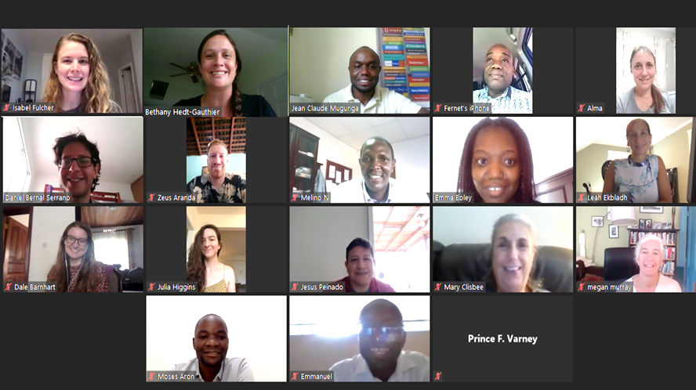
Informal
Biweekly meetings:
Present works in progress
Give feedback on methods and research.
Co-creating research works:
Opportunities for a range of individuals.
Mentoring/coaching for those leading the work.

Slide 63

Time series analysis course
Objective: Increase confidence in surveillance methods; train statisticians to implement these methods in R.
Format:
Five sessions, fully online
1 hour general content; 2 hours statistical content
https://isabelfulcher.github.io/CIHR_training_course/

Slide 64
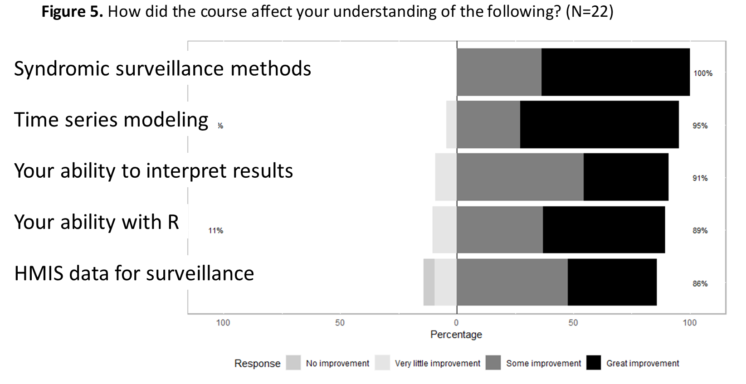

Slide 65
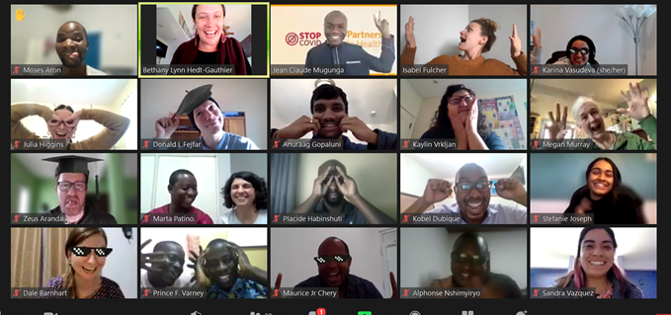
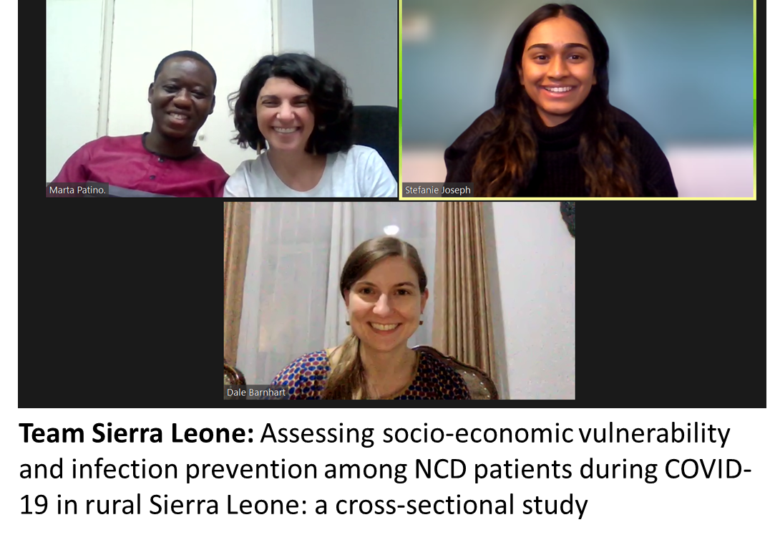
Writing workshop
Goal: Support six teams to produce papers from a set of available data.
Pre-workshop: Met with teams one-on-one to finalize results.
Workshop: Some core didactic lectures, lots of one-on-one time with mentor support.

Slide 66
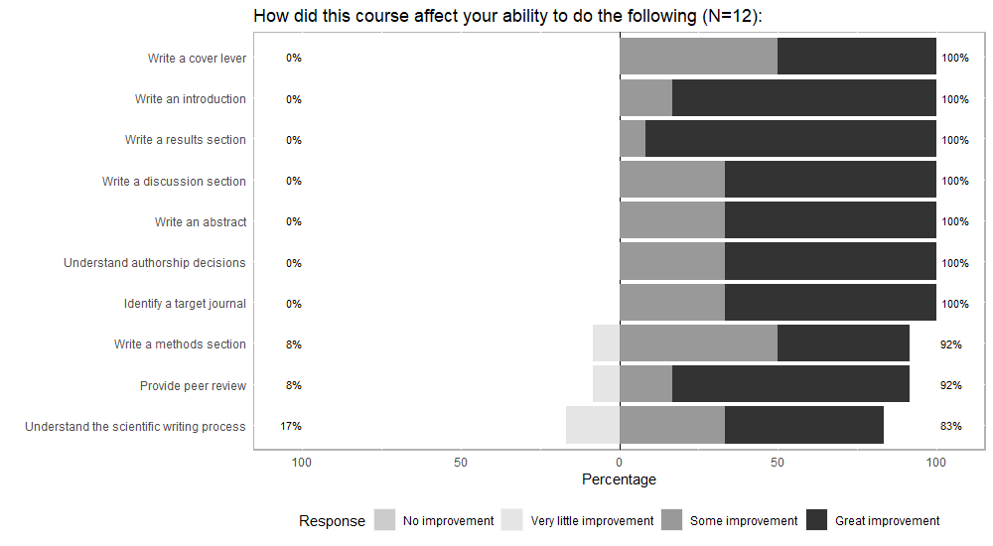

Slide 67
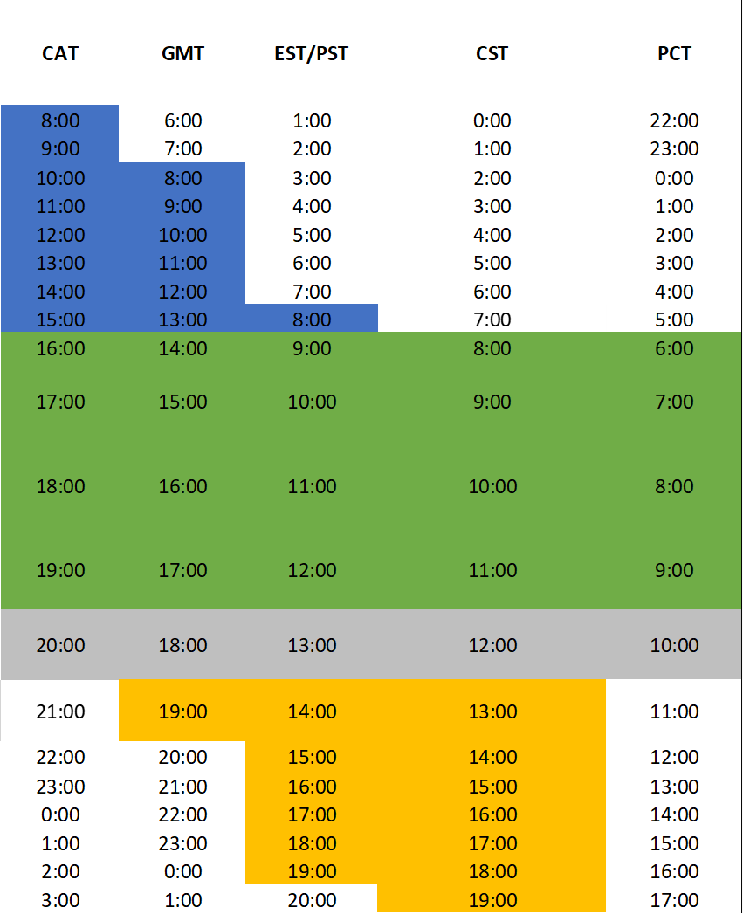
Lessons learned:
Lots of interest, more than we could satisfy.
Must prioritize accompaniment – supporting each other until achieve common goal.
Not everything for everyone – tailor to the needs of participants and offer enough to cover a range of needs/interests.
Be sensitive to time-zones and internet connectivity.

Slide 68
Questions/Feedback?
Bethany_Hedt@hms.Harvard.edu
@BHedtGauthier

Slide 69
Panel Q&A
Alphonse Nshimyiryo, MS (Virtual)
The impact of COVID-19 on access to cancer care in Rwanda
Zeus Aranda, MS
Implementation and evolution of a community health worker-led COVID-19 contact tracing intervention in Chiapas, Mexico
Marco Tovar, MD
Seroprevalence of SARS-CoV-2 infection in Carabayllo, Peru
Emilia Connolly, MPH, MD
Childhood immunization during the COVID-19 pandemic
Bethany Hedt-Gauthier, PhD
Integrating capacity building into our multisite research

